Slide 1

End-to-End Business Intelligence Project
From Data Base creation to Power BI & AI Analytics
A comprehensive transformation initiative integrating data design, warehousing, visualization, and artificial intelligence to drive enterprise decision-making.

Slide 2





Meet Our Project Team
Our success is driven by a dedicated and experienced team, each bringing unique expertise to deliver a robust and insightful Business Intelligence solution.
Mohammed Ghanaym
Abelwahed Nasr
Basma Hesham
Reaal Salah
Sondos Mohammed

Slide 3
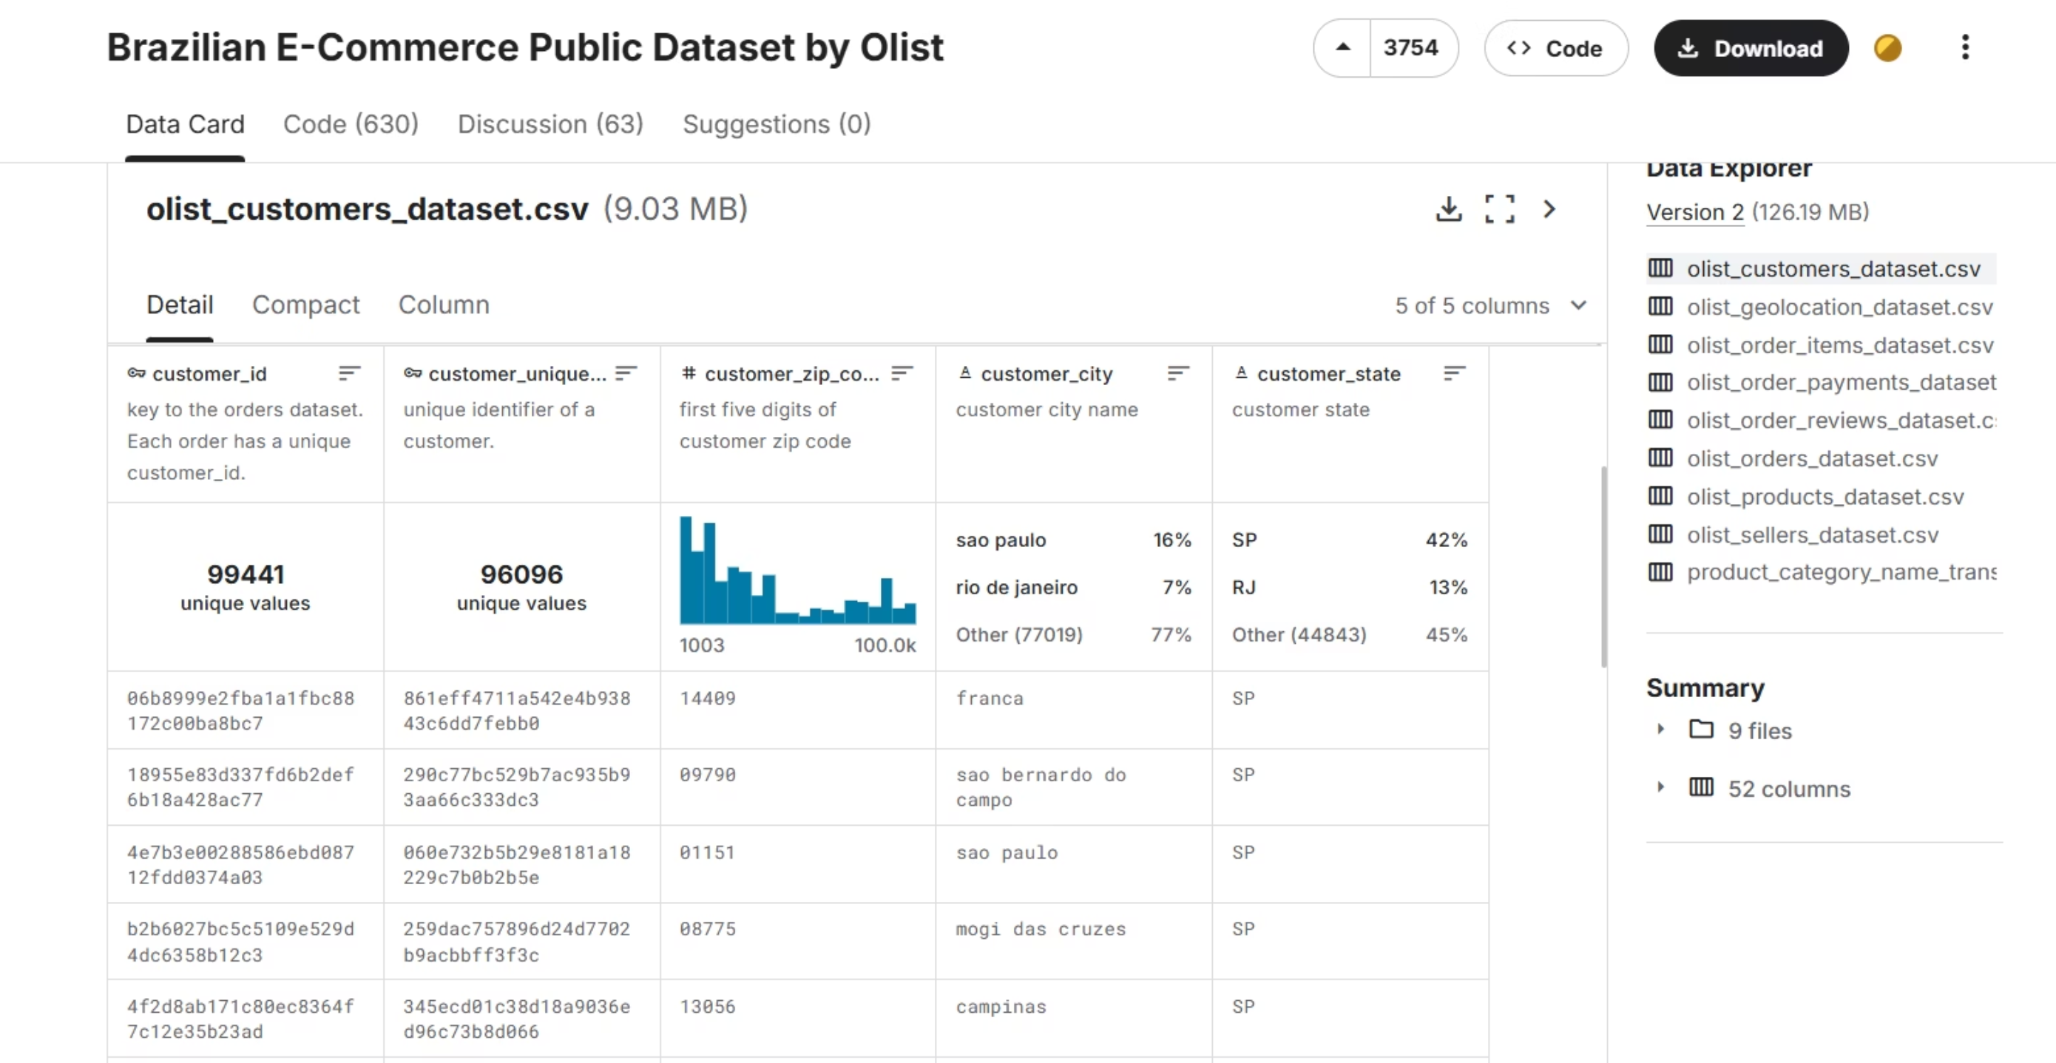
Data Source Overview
A successful Business Intelligence project begins with a clear understanding of all available data sources. We identify and categorize internal and external data streams that will feed into our analytical systems.

Slide 4

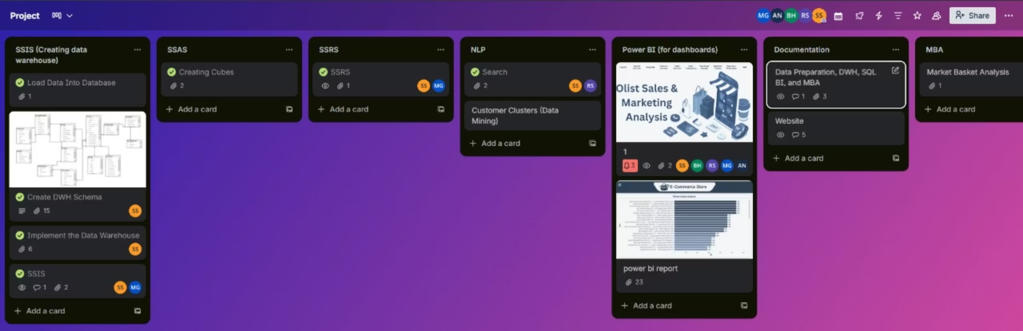
Project management to order and assign tasks
We used Trello as a project management tool to organize our tasks, track progress, and ensure efficient collaboration throughout the project.

Slide 5

Project Roadmap
Strategic phases from data modeling through AI-driven analytics delivery.
Database Design
Designed ERD diagram and mapped data structure.
Data Implementation
Implemented SQL database, and created stored procedures.
ETL Development
Build SSIS pipelines for data integration; generate derived datasets and implement incremental load strategies.
Analytics Layer
Construct SSAS cubes.
Reporting Layer
create SSRS reports and Power BI dashboards.
Advanced Analytics
Deploy Python-based predictive models and machine learning algorithms for strategic insights.

Slide 6
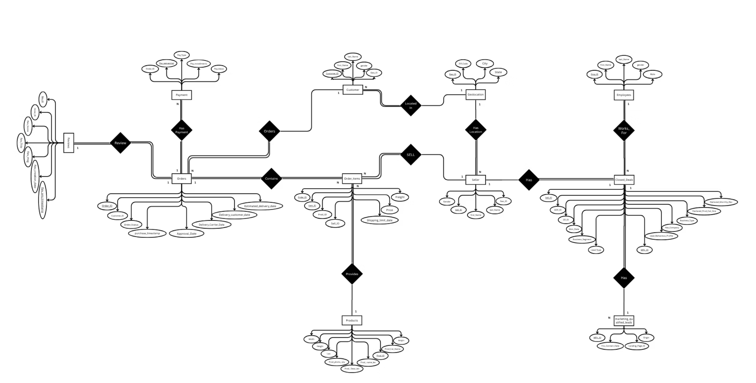
Entity Relationship Design
Normalized dimensional data model supporting efficient analytics and reporting.

Slide 7
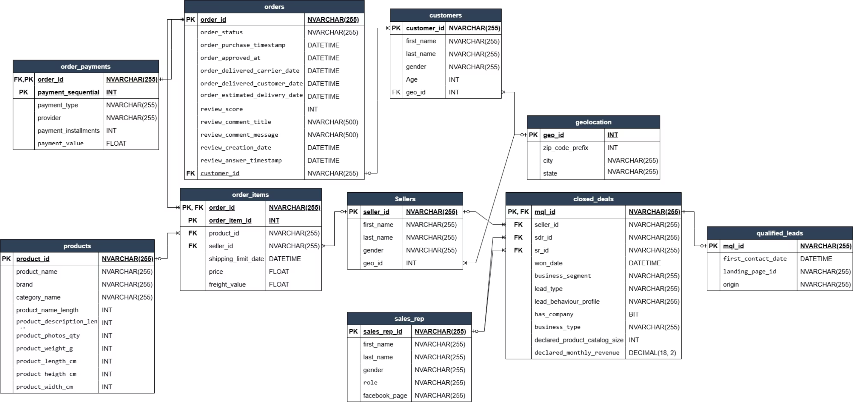
Data Mapping & Transformation
Systematic conversion from source systems to analytical data warehouse structures.

Slide 8

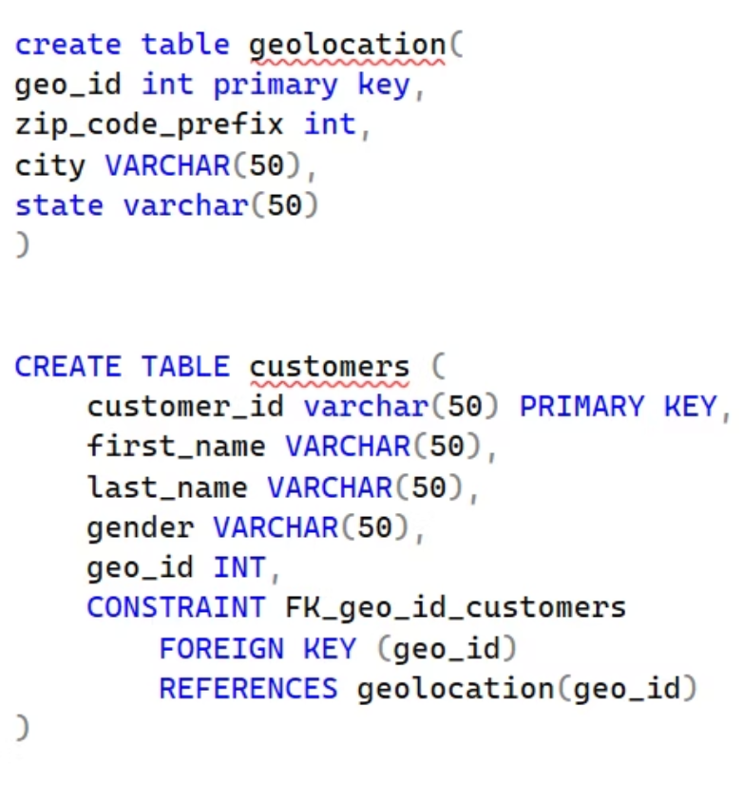
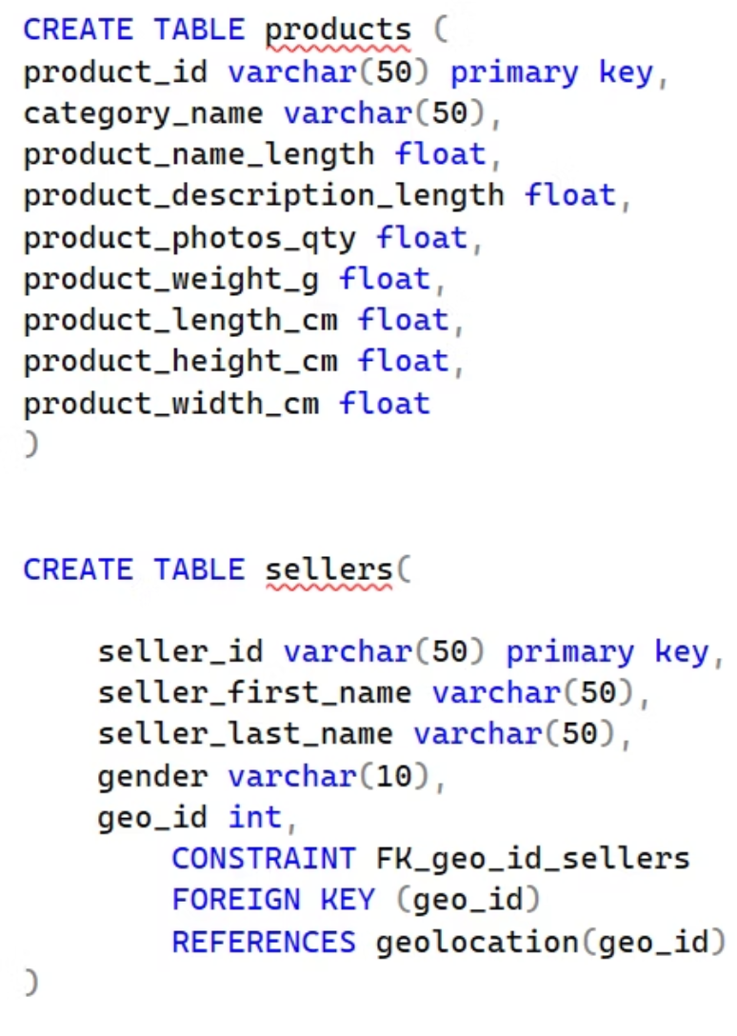
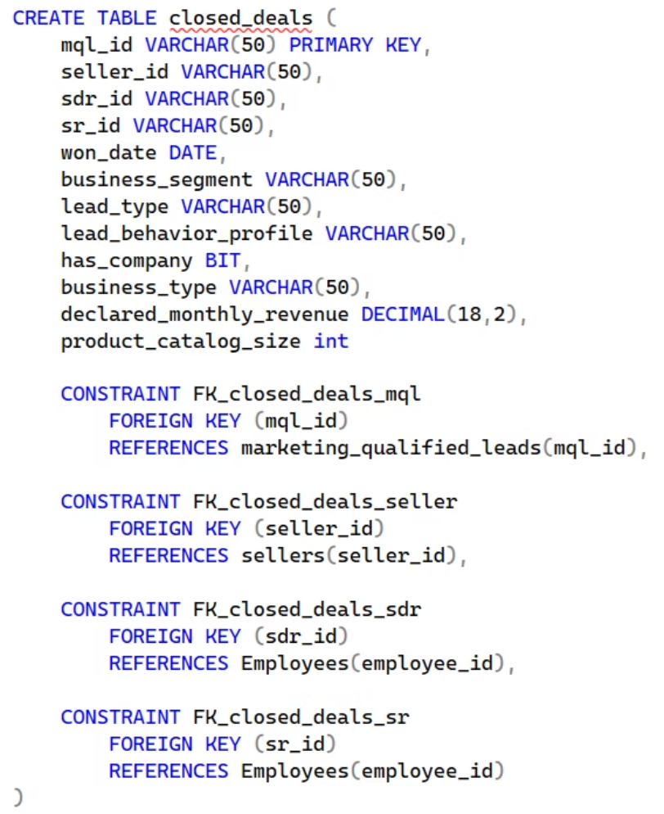
SQl Database implementation
This project represents the implementation of an Entity-Relationship Diagram (ERD) into a structured relational database using SQL.

Slide 9
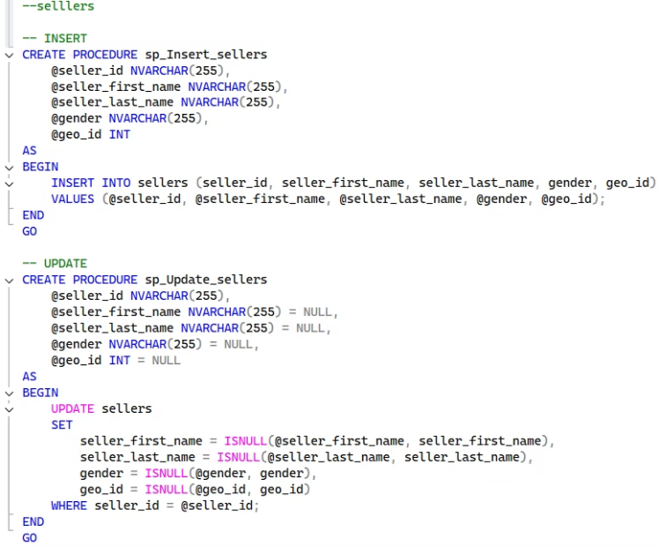
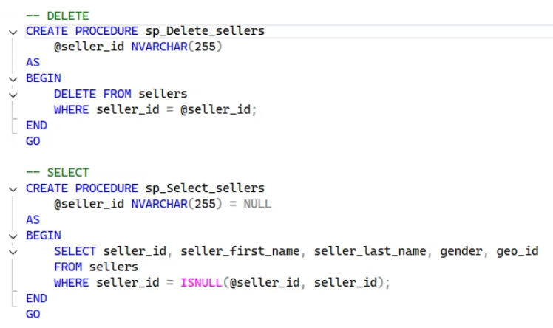
Stored Procedures:
As part of the SQL database development, a set of stored procedures was created to manage basic data operations efficiently.
These procedures were designed to handle:• INSERT – adding new records• UPDATE – modifying existing records• SELECT – retrieving specific data• DELETE – removing unnecessary or duplicate records
Below are examples of the stored procedures implemented in the project.

Slide 10
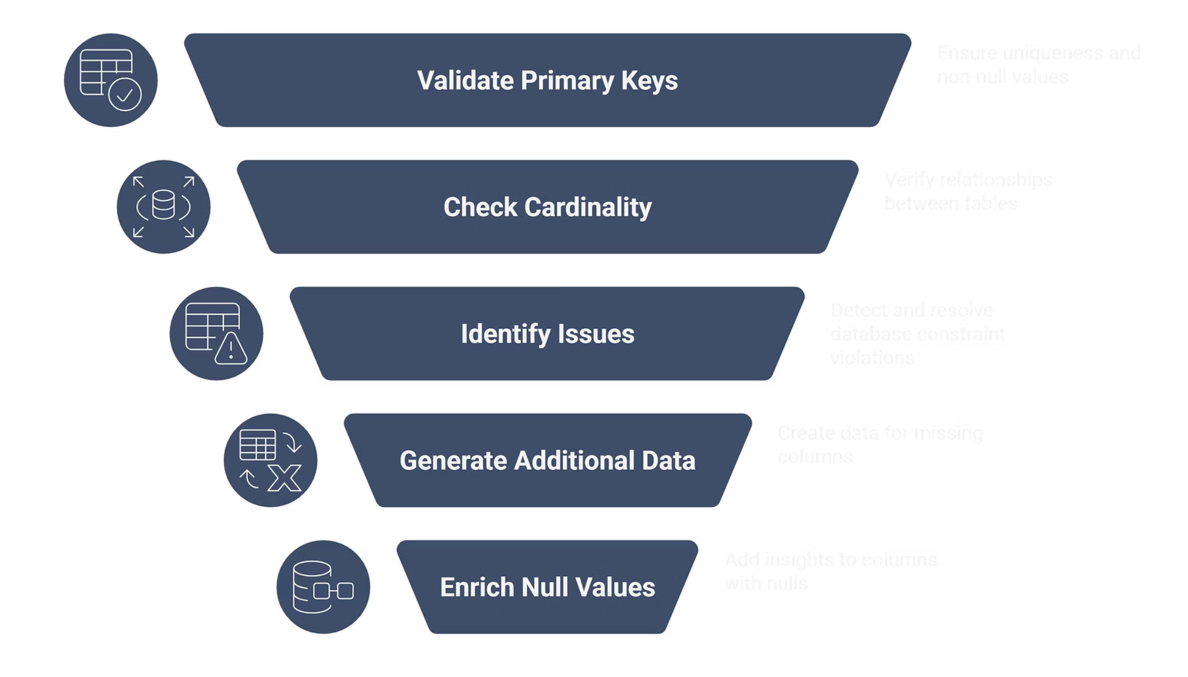
Data Validation & Enrichment

Slide 11
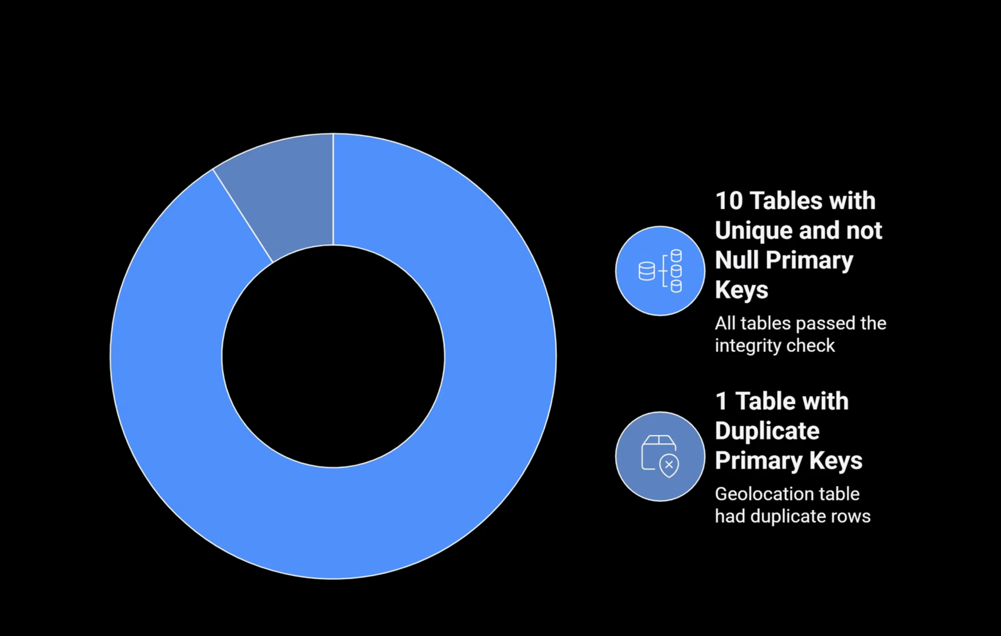
Primary Key Integrity Check

Slide 12
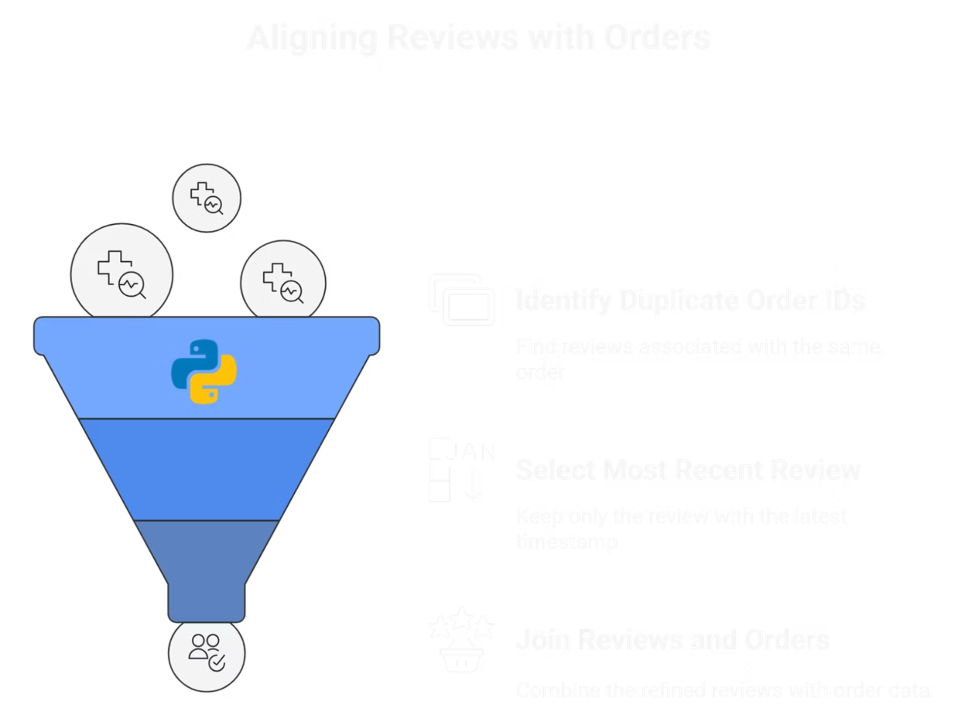
Cardinality Verification

Slide 13
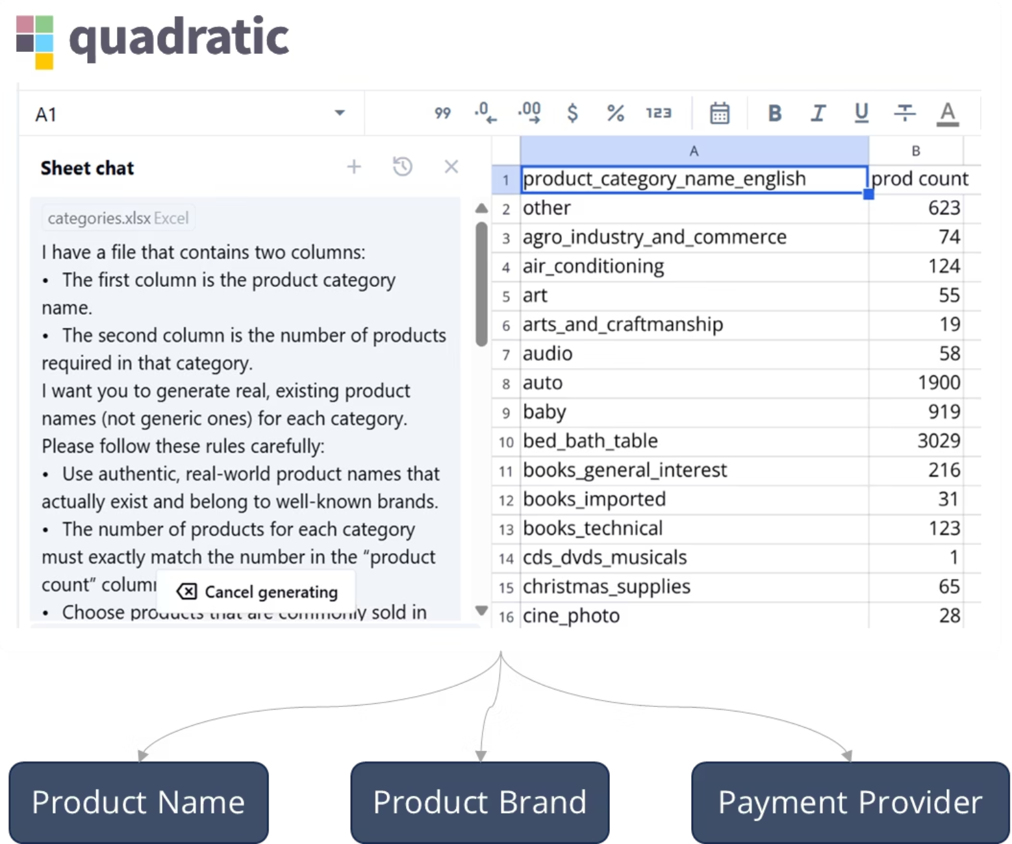
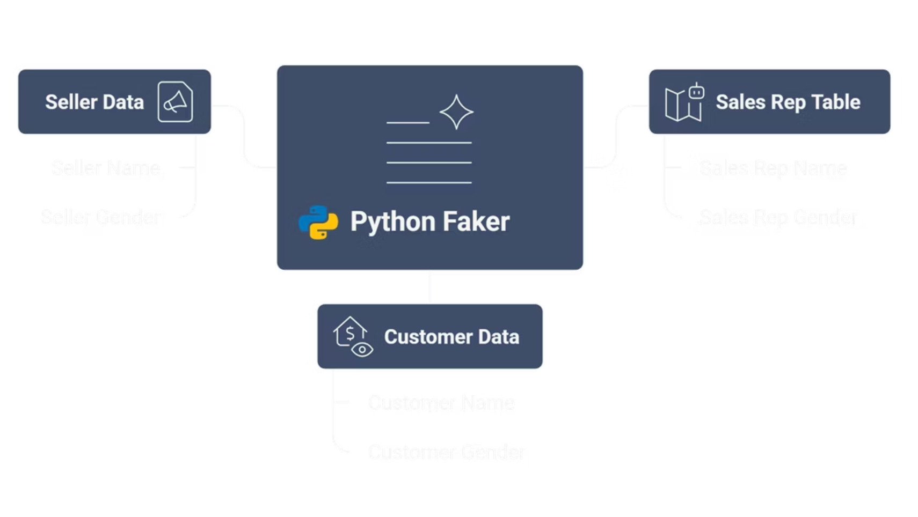
Data Generation and Enrichment

Slide 14
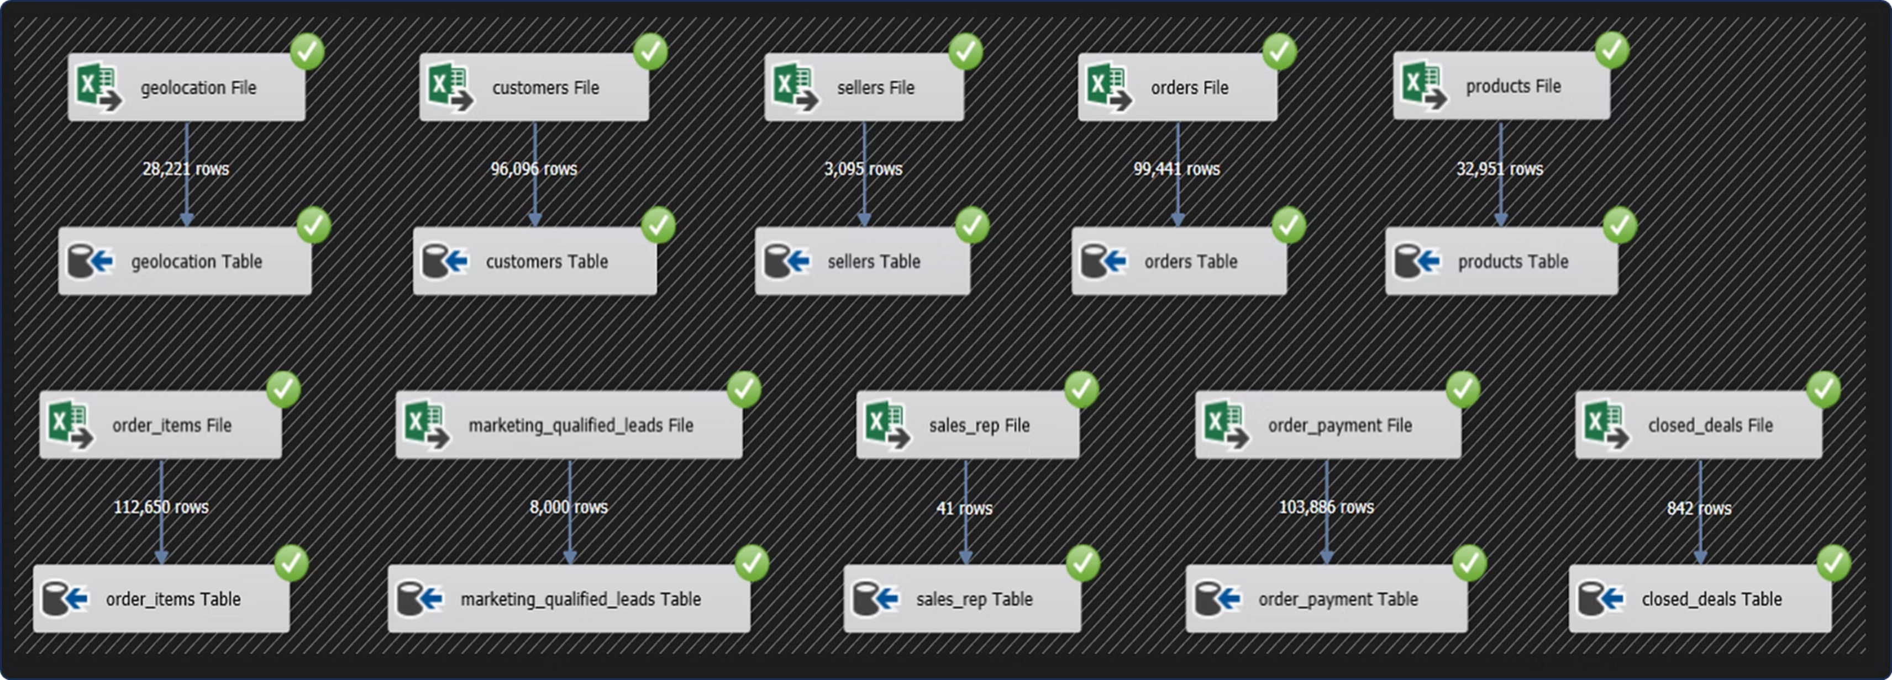
Loading the data into the Database

Slide 15
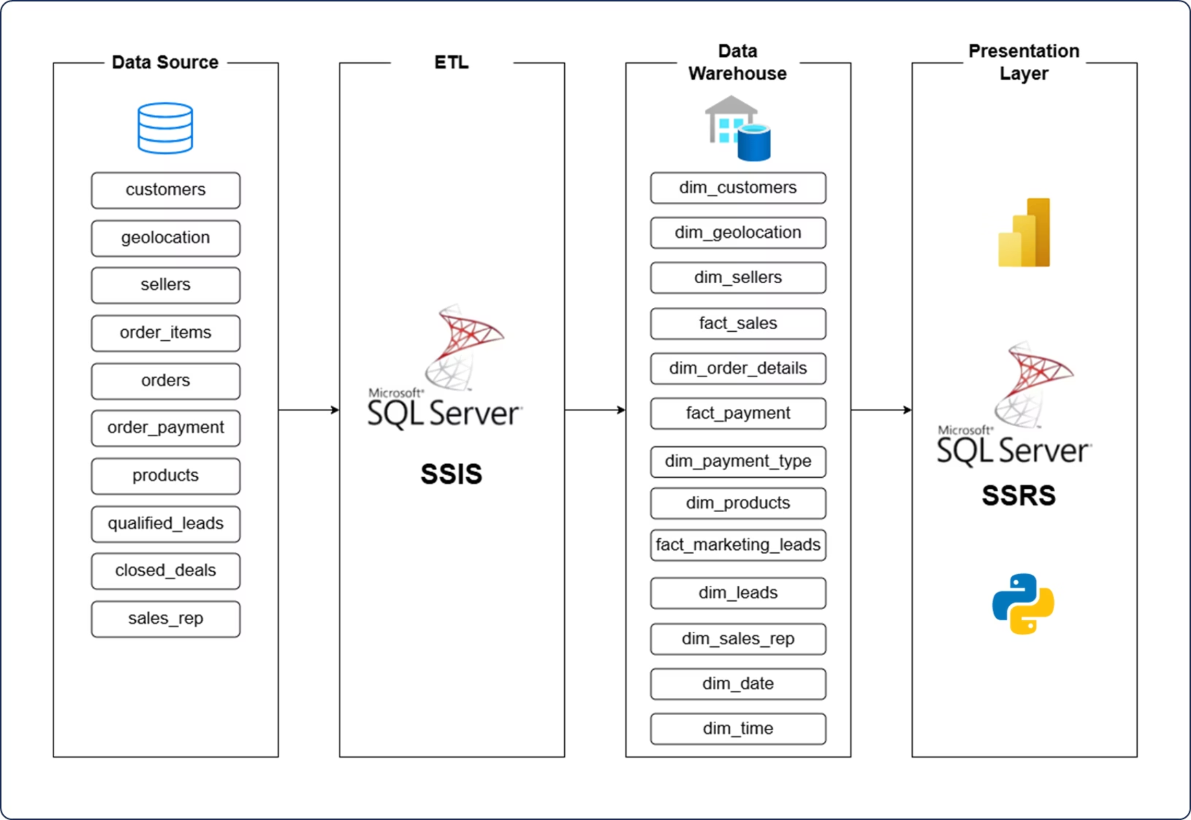
Data Warehouse Architecture

Slide 16
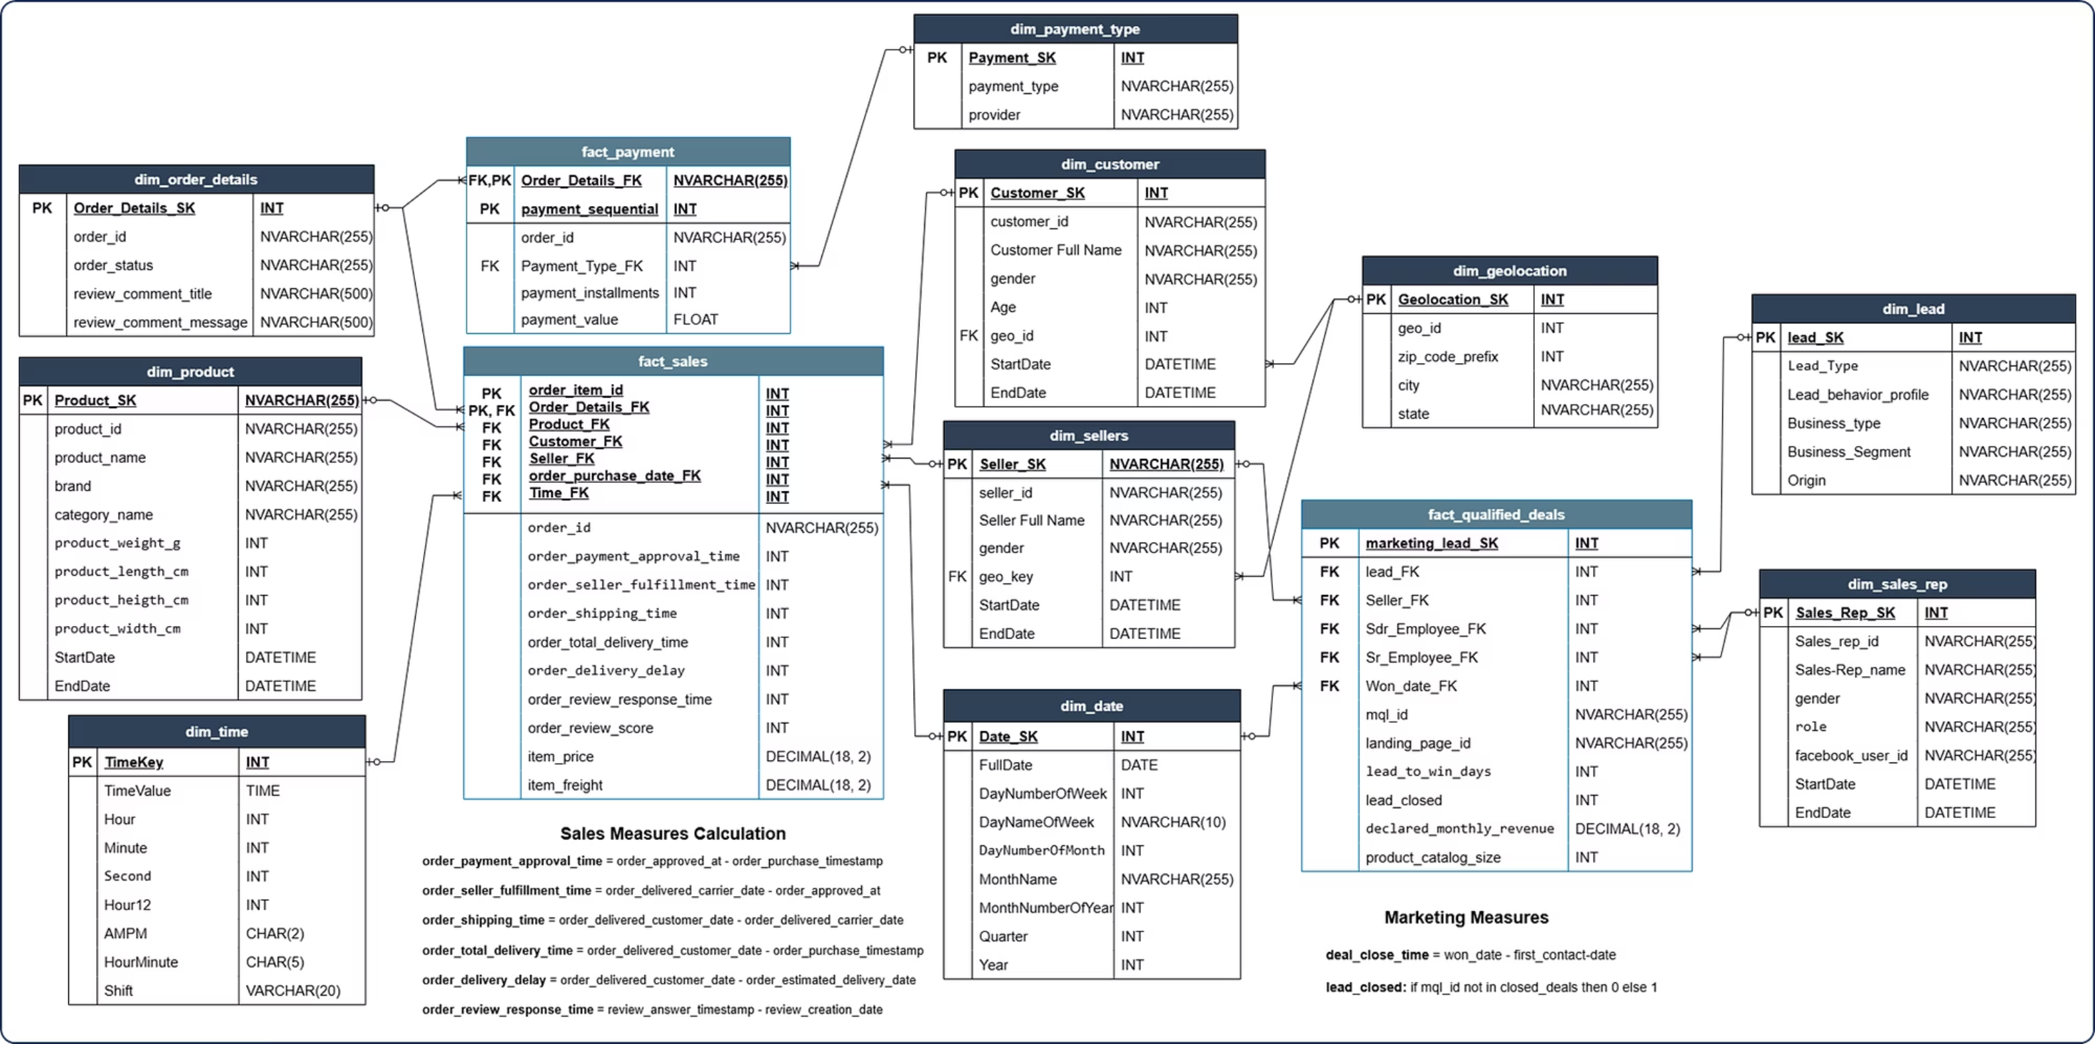
Data Warehouse Schema

Slide 17
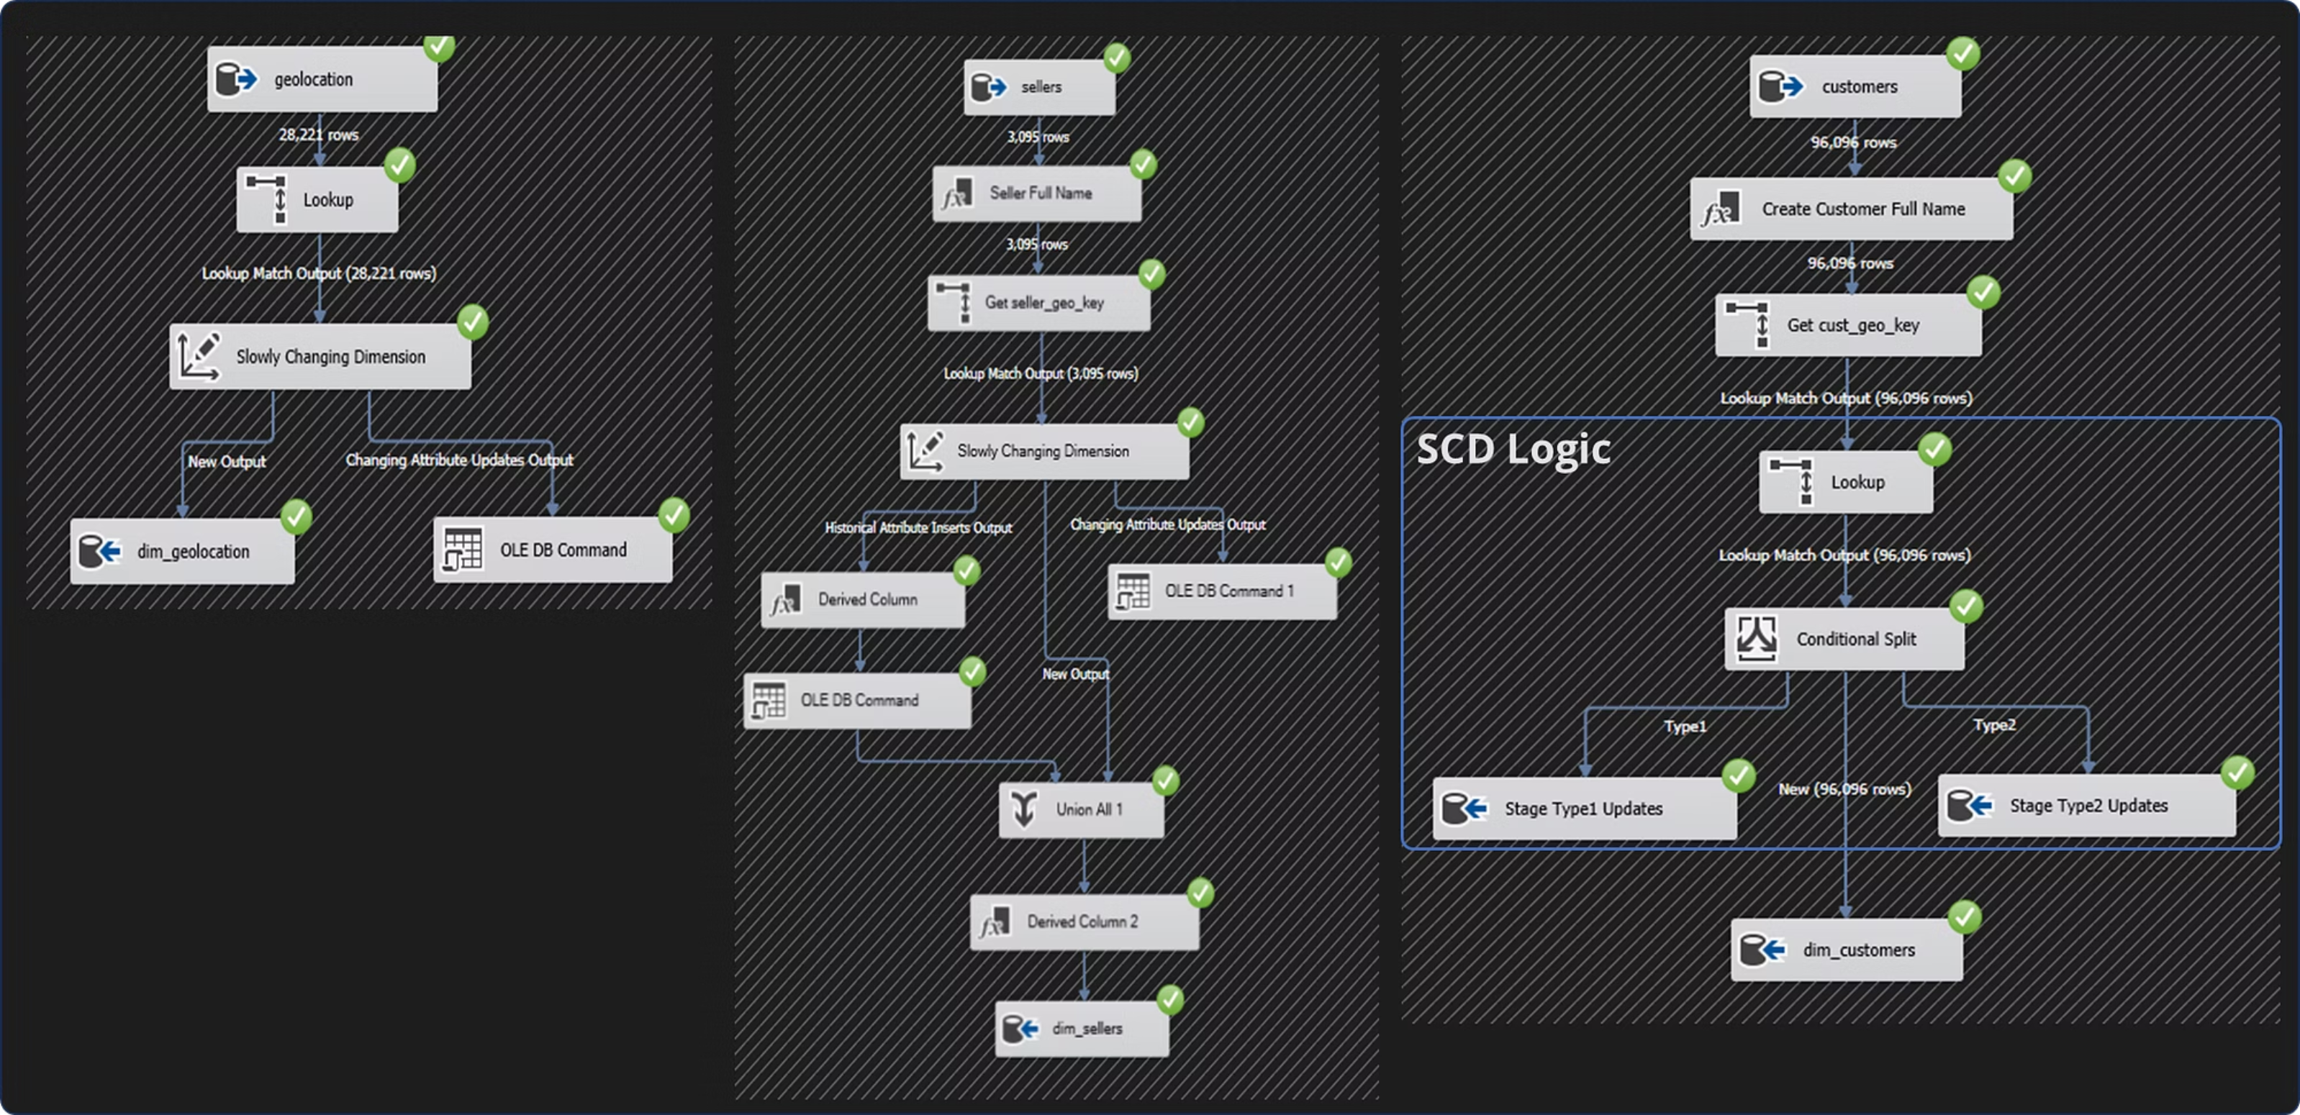
ETL Processes (SSIS)

Slide 18
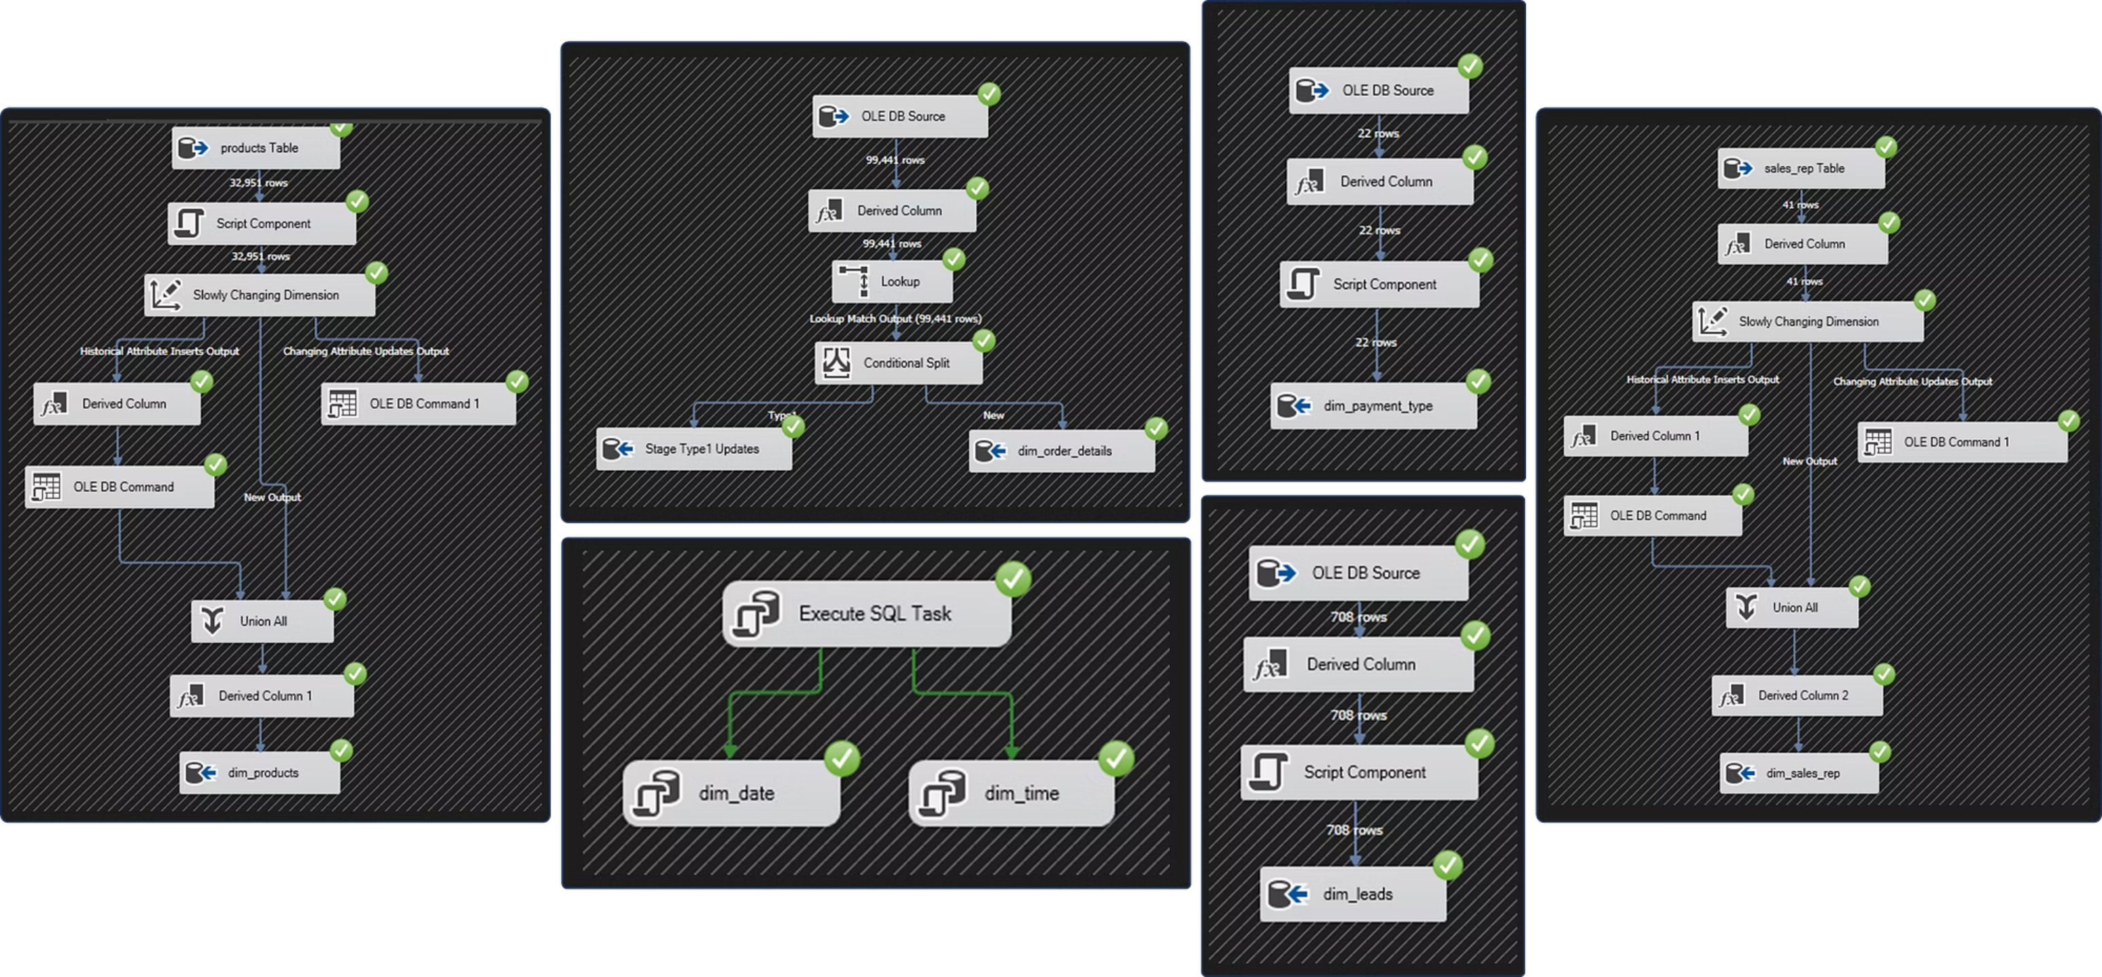
ETL Processes (SSIS)

Slide 19
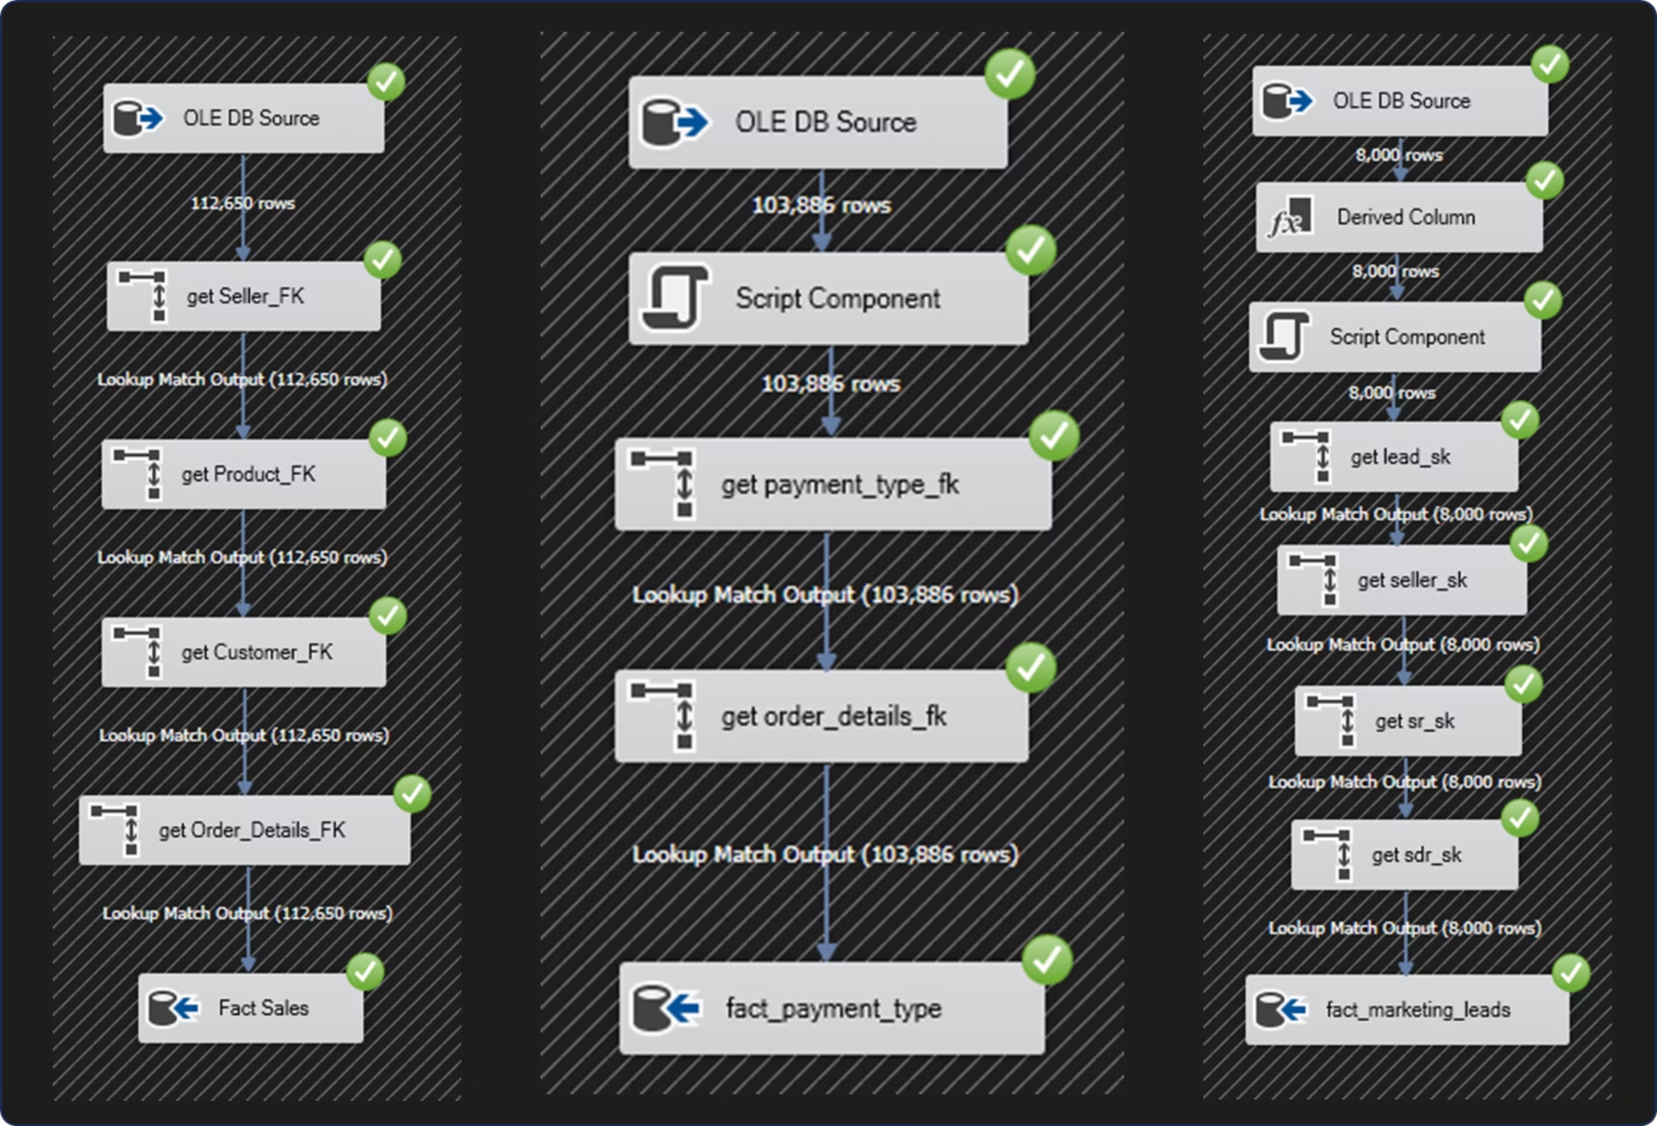
ETL Processes (SSIS)

Slide 20
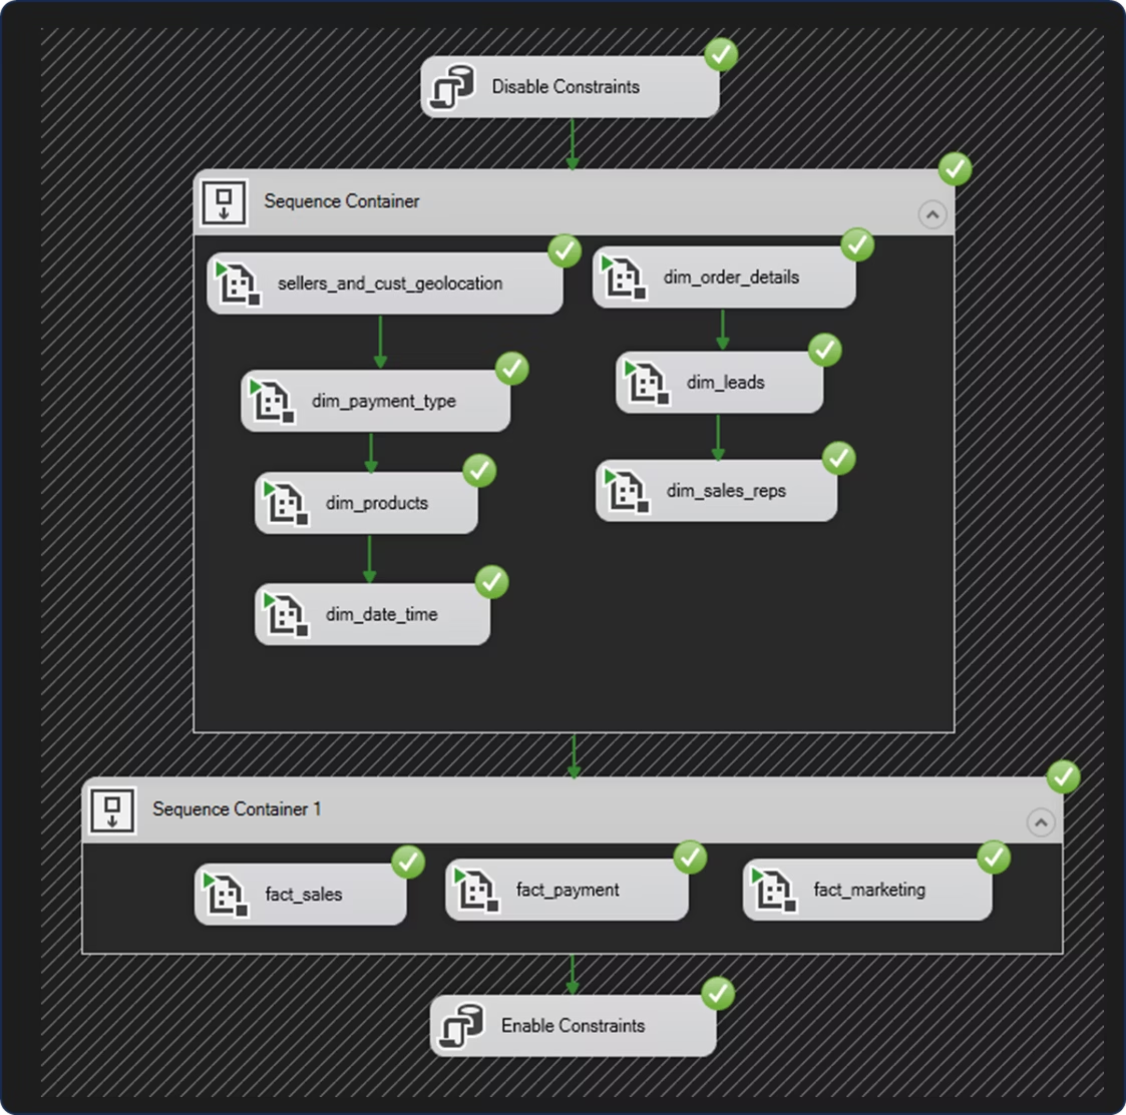
ETL Processes (SSIS)

Slide 21
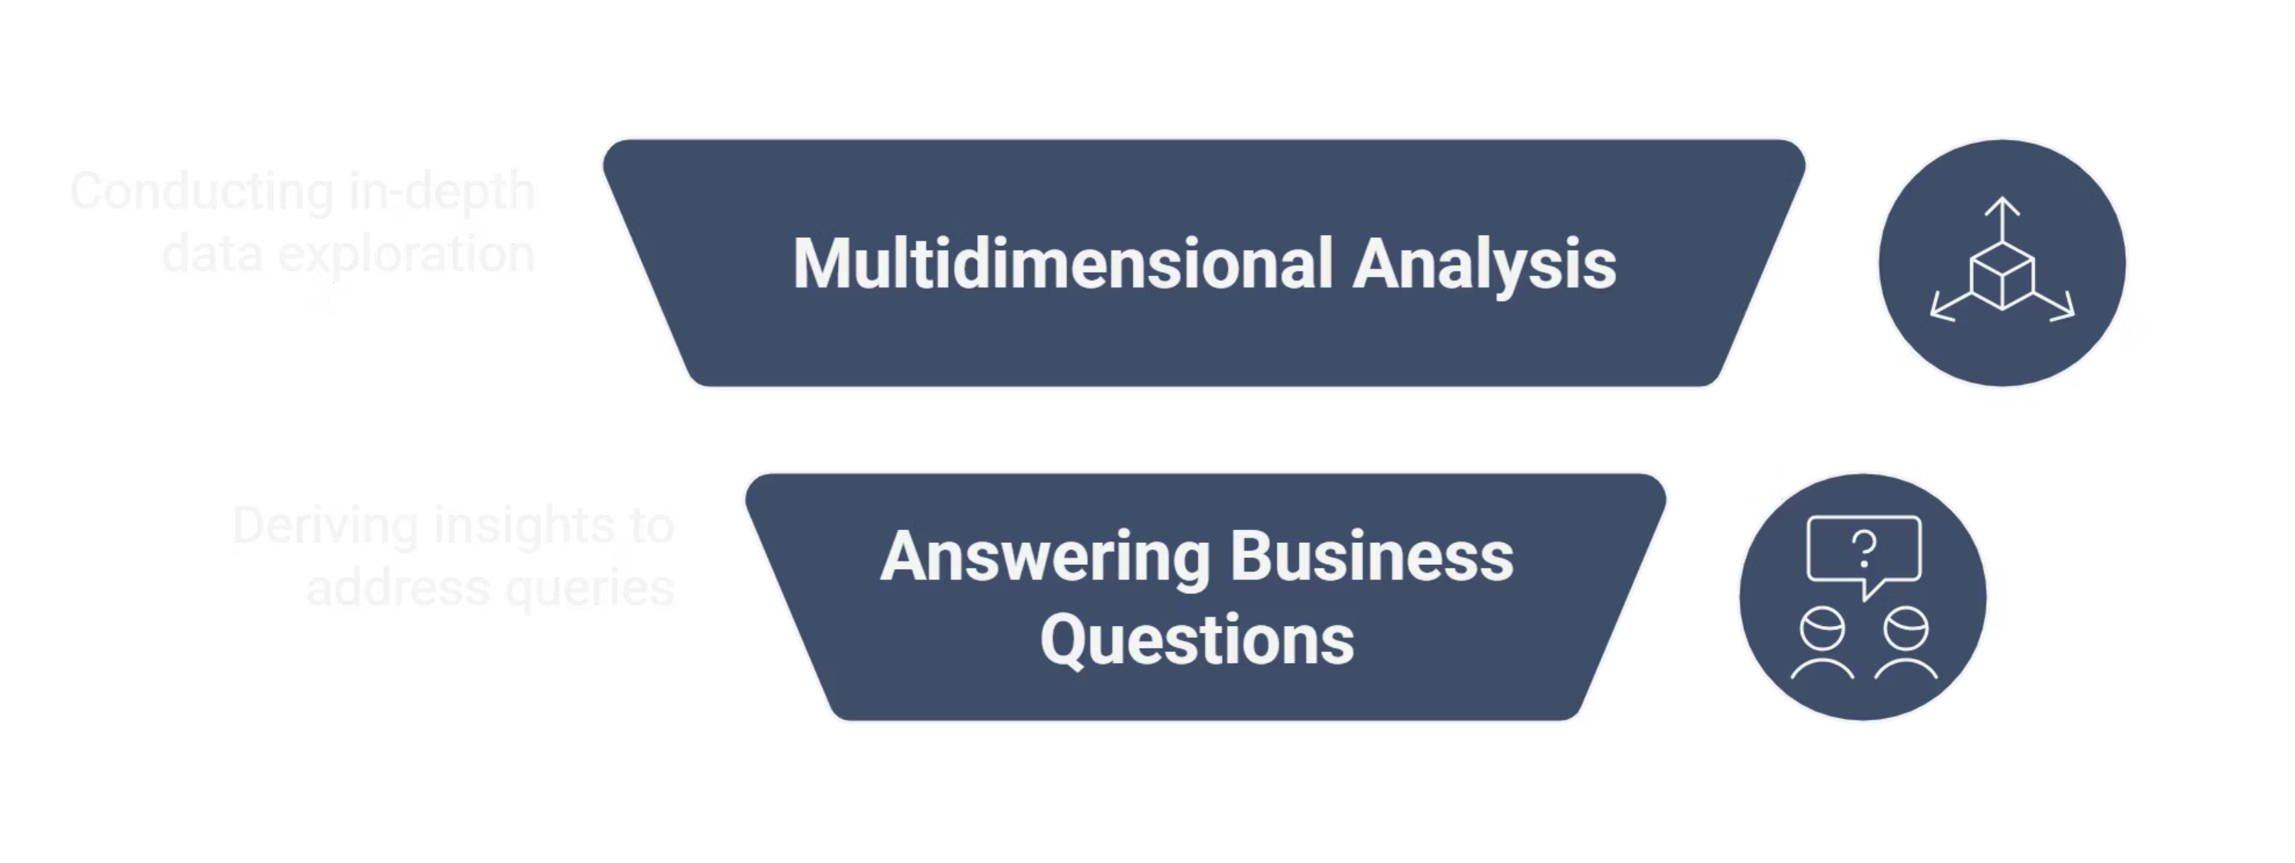
Analyzing Data in SSAS
After successfully loading all the data into the data warehouse, the next step was to perform multidimensional analysis to answer key business questions.

Slide 22
Our 6 Core Business Questions
Our goal was to answer 6 critical business questions. We built the SSAS engine to create Reports that provide these answers clearly and instantly.
Sales Performance by State
Seller Performance
A report for sales managers to see which states are most profitable and which have high delivery delays.
A report for account managers to identify top-performing Sellers and those who might be a risk to the business.
Delivery Performance Over Time
Payment Provider Performance
A report for the logistics team to monitor delivery efficiency and see if delays are caused by Sellers or the shipping Carriers.
A report for the finance team to analyze which payment methods are most valuable and which are linked to Canceled Orders.
Marketing Channel Performance
Sales Rep Performance
A report for the marketing team to measure the true Conversion Rate of each channel, not just the number of leads.
A report for sales management to identify the most efficient Sales Reps (who close deals fastest), not just the ones who close the most.

Slide 23



SSAS Project Structure: Analytical
To streamline analysis and provide tailored insights, the SSAS project is structured into three specialized analytical cubes.
Sales
Payment
Marketing
Designed for comprehensive sales performance analysis, including revenue, product profitability, and customer purchasing trends.
Focuses on transaction data, payment method analysis, and financial reconciliation to track monetary flows.
Provides insights into campaign effectiveness, lead generation, customer acquisition costs, and market segmentation.
Each cube is built upon its own Data Source View (DSV), creating a distinct business layer for relevant departmental analytics.

Slide 24
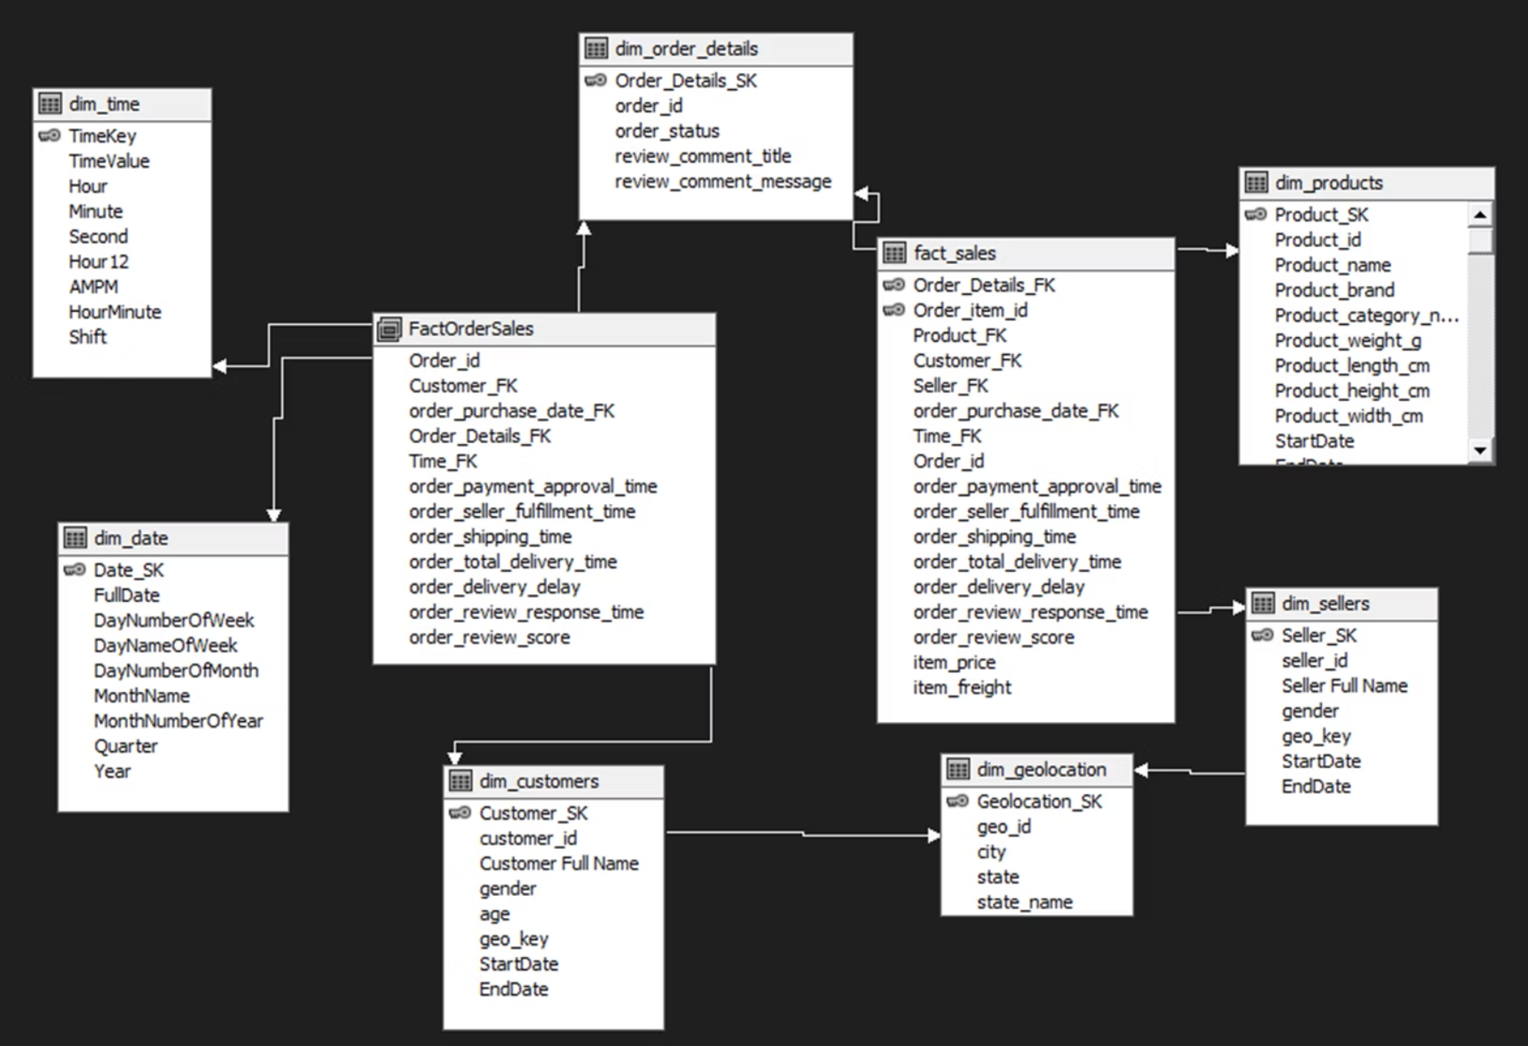
Sales View
Description: This view defines the logical model for our Sales Cube. It combines all sales, logistics, and customer data to answer key business questions.
This DSV was built to power the following reports:
Delivery Performance over Time
Sales Performance by State
Seller Performance

Slide 25
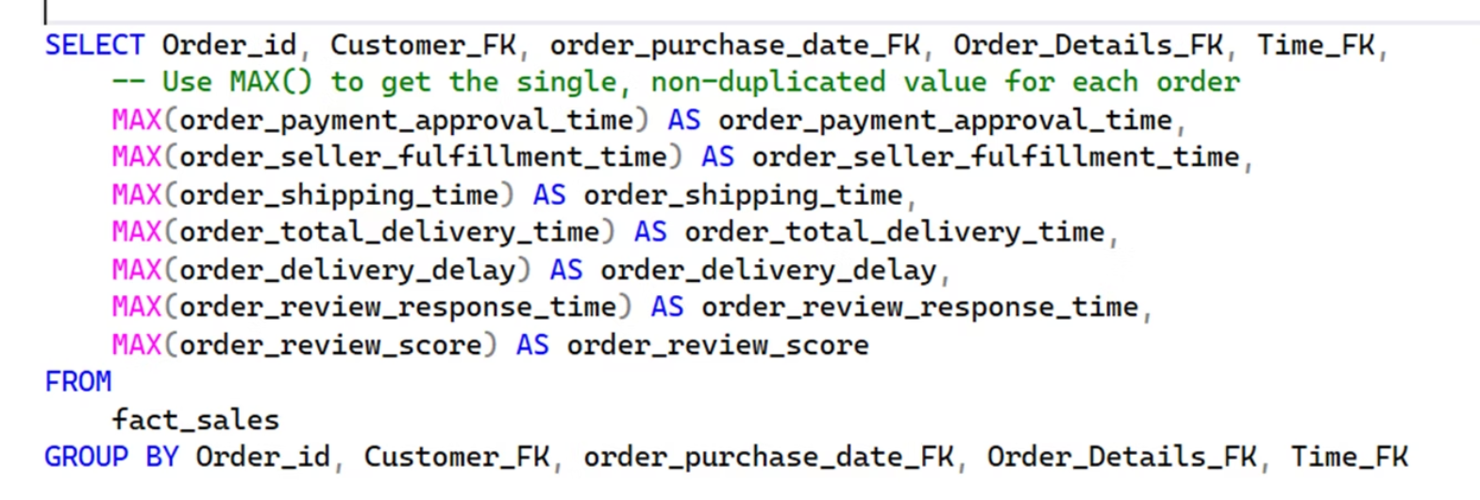
SalesOrderFact SQL (Named Query)
Problem: We had mixed Granularity (Item-level data like Price and Order-level data like Delivery Time).
Solution: We created a Named Query using GROUP BY.
This ensures all order-level metrics are accurate.

Slide 26
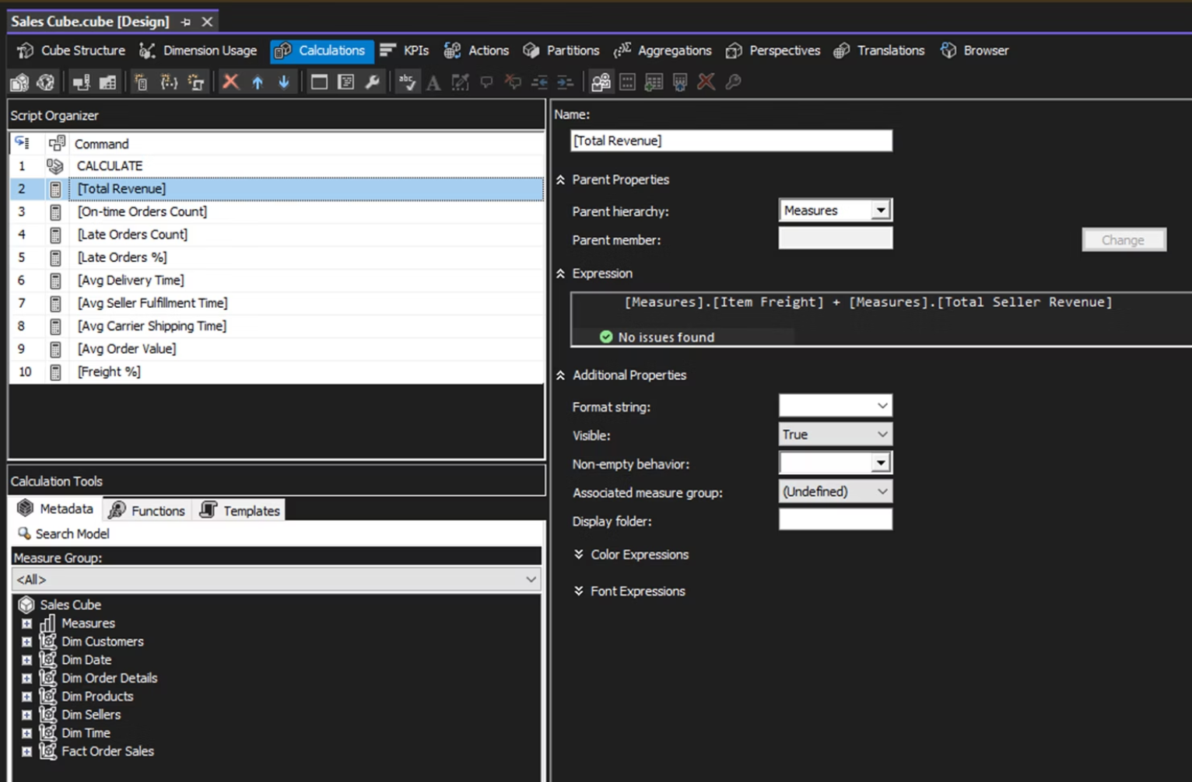
Sales Cube Calculated Measures
The real power of SSAS is in Calculated Measures.
This is where we turn raw numbers into business-ready answers.

Slide 27
Sales Cube Calculated Measures
Measure
Description
Total Revenue
Combines product and freight revenue for total sales value.
On-time Orders Count
Counts all orders delivered on or before the estimated date.
Late Orders Count
Counts all orders delivered after the estimated delivery date.
Late Orders %
Calculates the percentage of delayed deliveries.
Avg Delivery Time
Measures average total delivery duration per order.
Avg Seller Fulfillment Time
Measures average time sellers take to prepare and dispatch orders.
Avg Carrier Shipping Time
Calculates average shipping duration handled by the carrier.
Avg Order Value
Measures average revenue per order.
Freight %
Indicates how much freight contributes to total revenue.

Slide 28
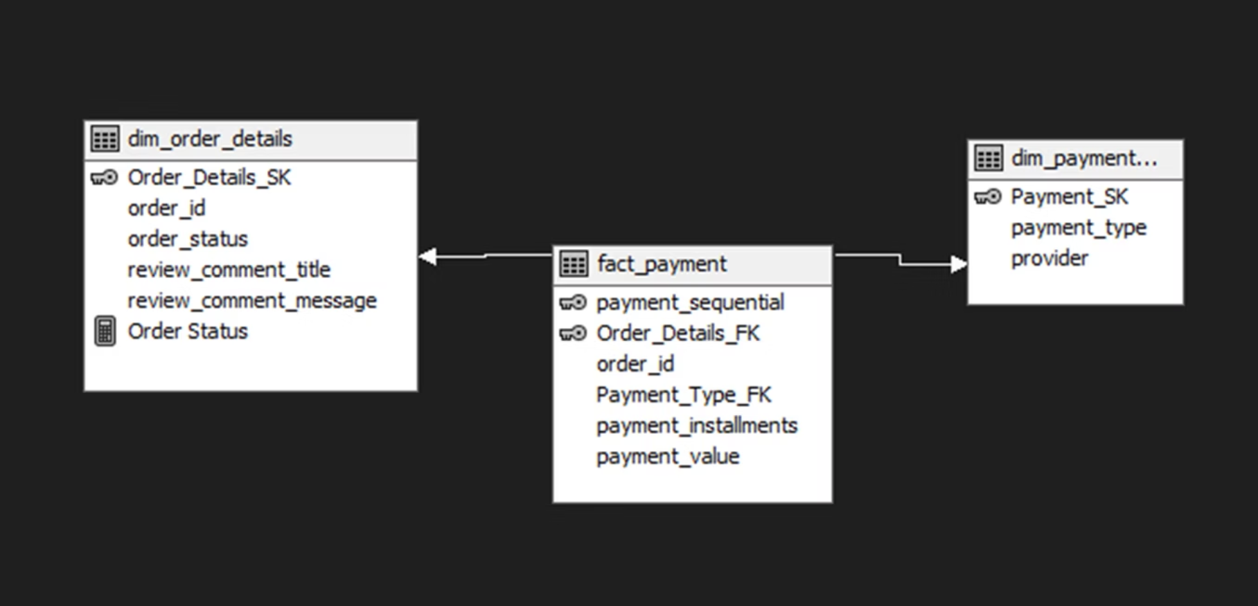
Payment View
Description: This view defines the logical model for our Payment Cube. It provides a focused model for financial analysis of transactions.
This DSV was built to power the:
Payment Provider Performance

Slide 29
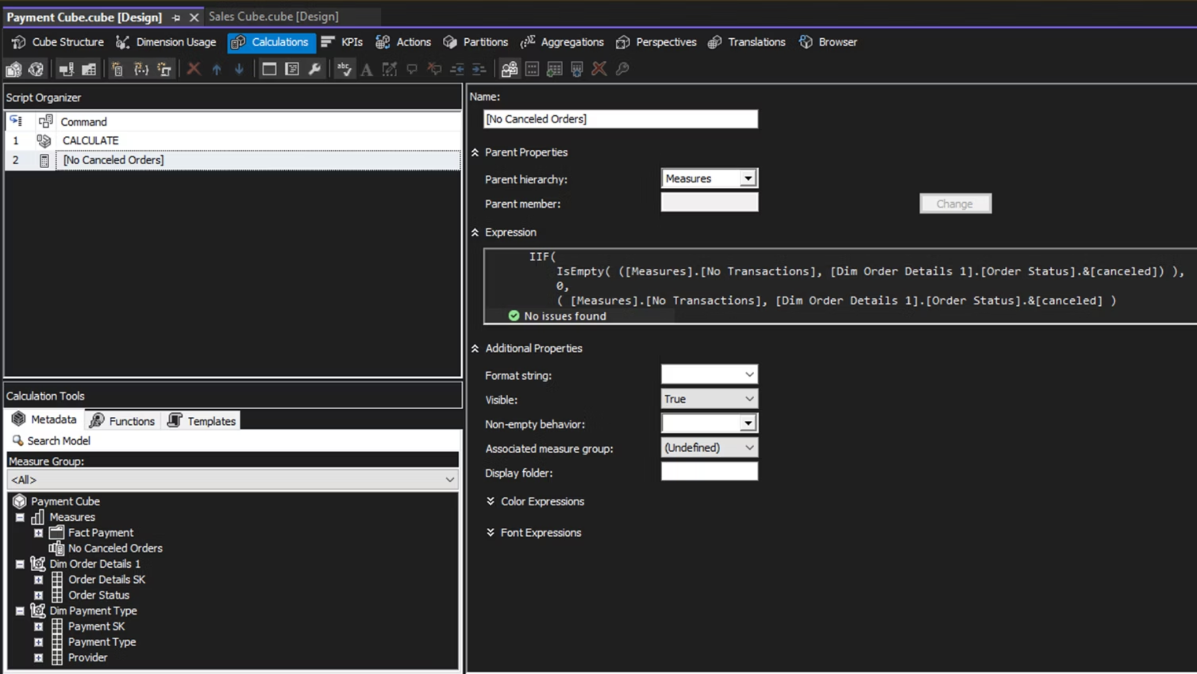
Payment Cube Measure
We must separate good transactions from bad ones.
We created No Canceled Orders to filter out any transaction with a "Canceled" status.

Slide 30
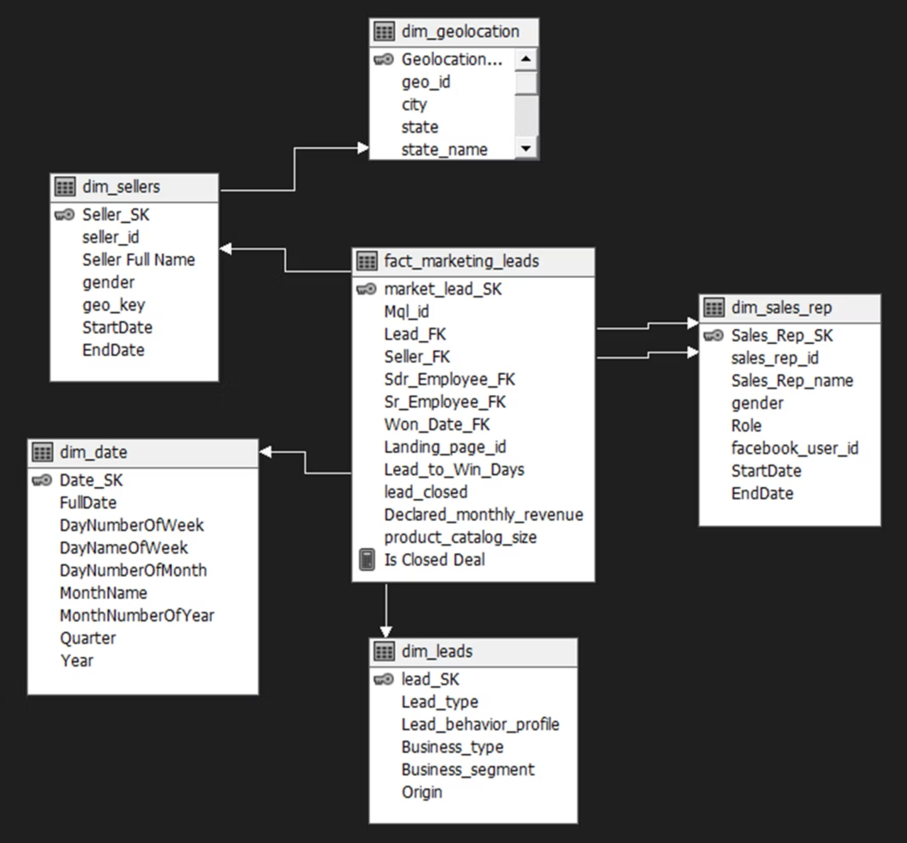
Marketing View
Description: This view defines the logical model for our Marketing Cube. It focuses on the marketing funnel and sales team efficiency.
This DSV was built to power our two key marketing reports:
Marketing Channel Performance
Sales Rep Performance Report

Slide 31
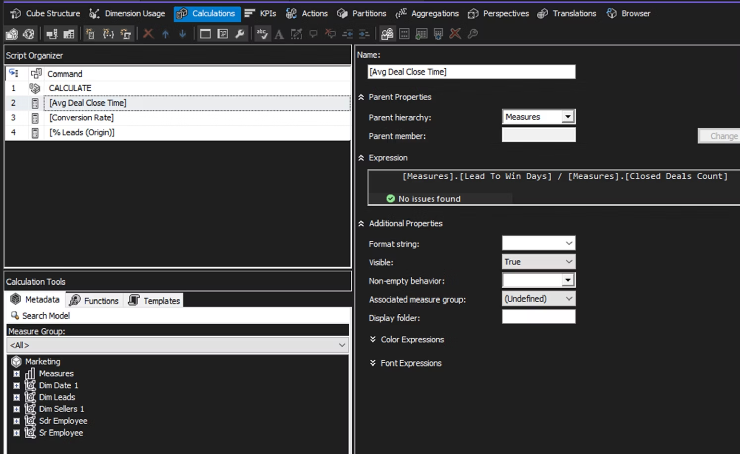
Marketing Cube Measures
Focus on seller acquisition and Sales Team performance.

Slide 32
Marketing Cube Measures
Measure Name
Description
Avg Deal Close Time
Calculates the average number of days it takes to close a deal from the time a lead is created.
Conversion Rate
Calculates the percentage of leads that were successfully converted into closed deals.
% Leads (Origin)
Calculates the proportion of leads from each marketing origin compared to total leads.

Slide 33
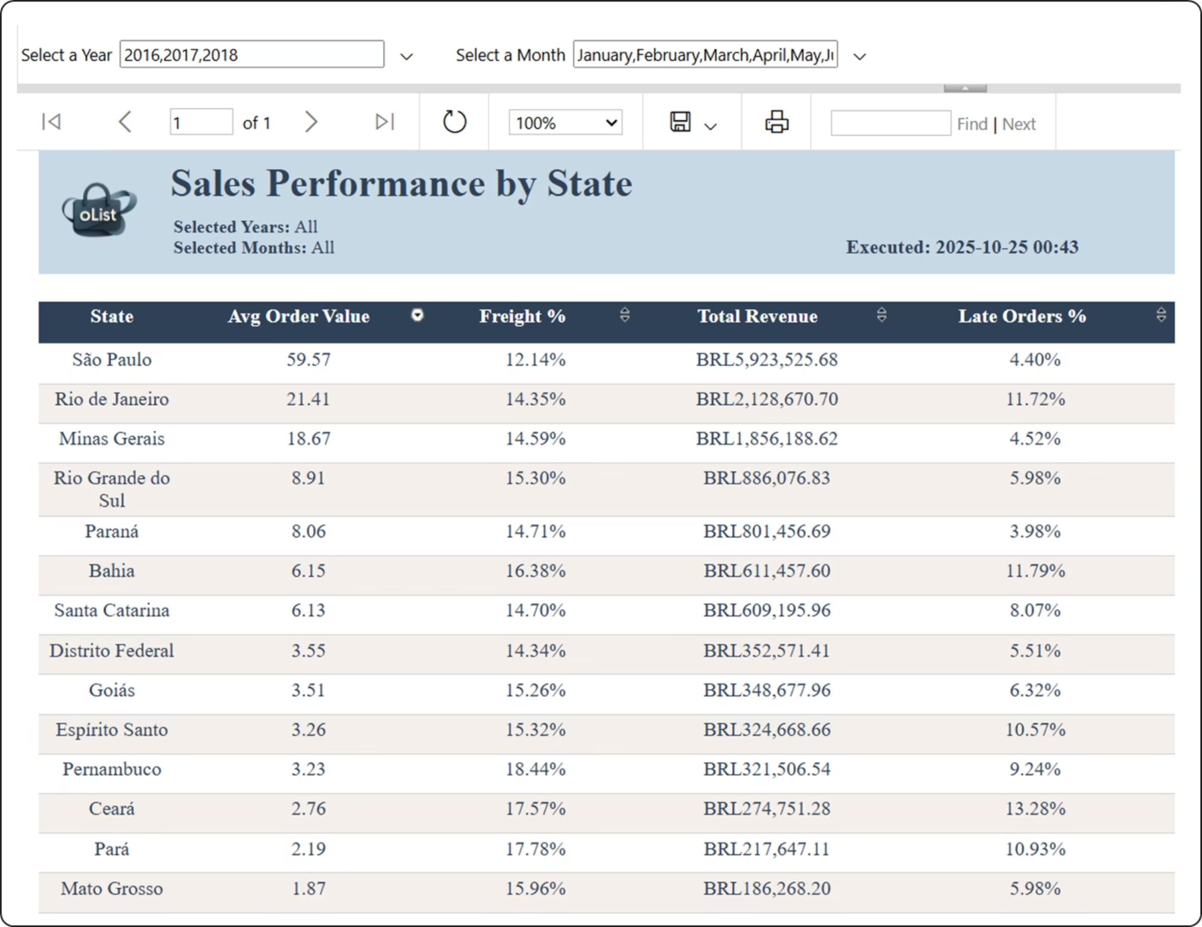
Reporting in SSRS

Slide 34
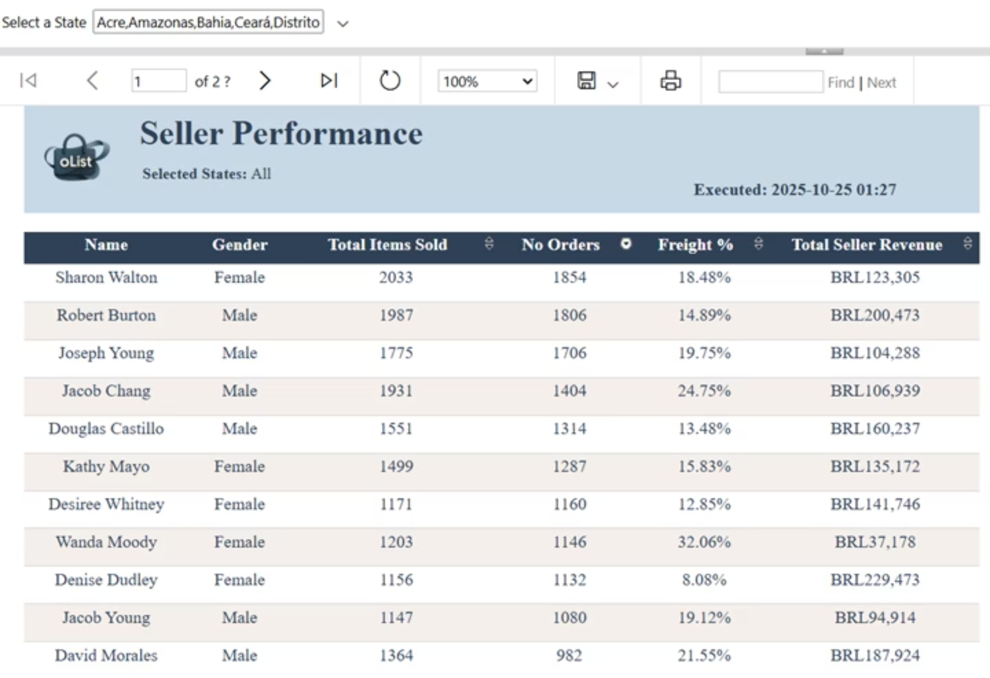

Slide 35
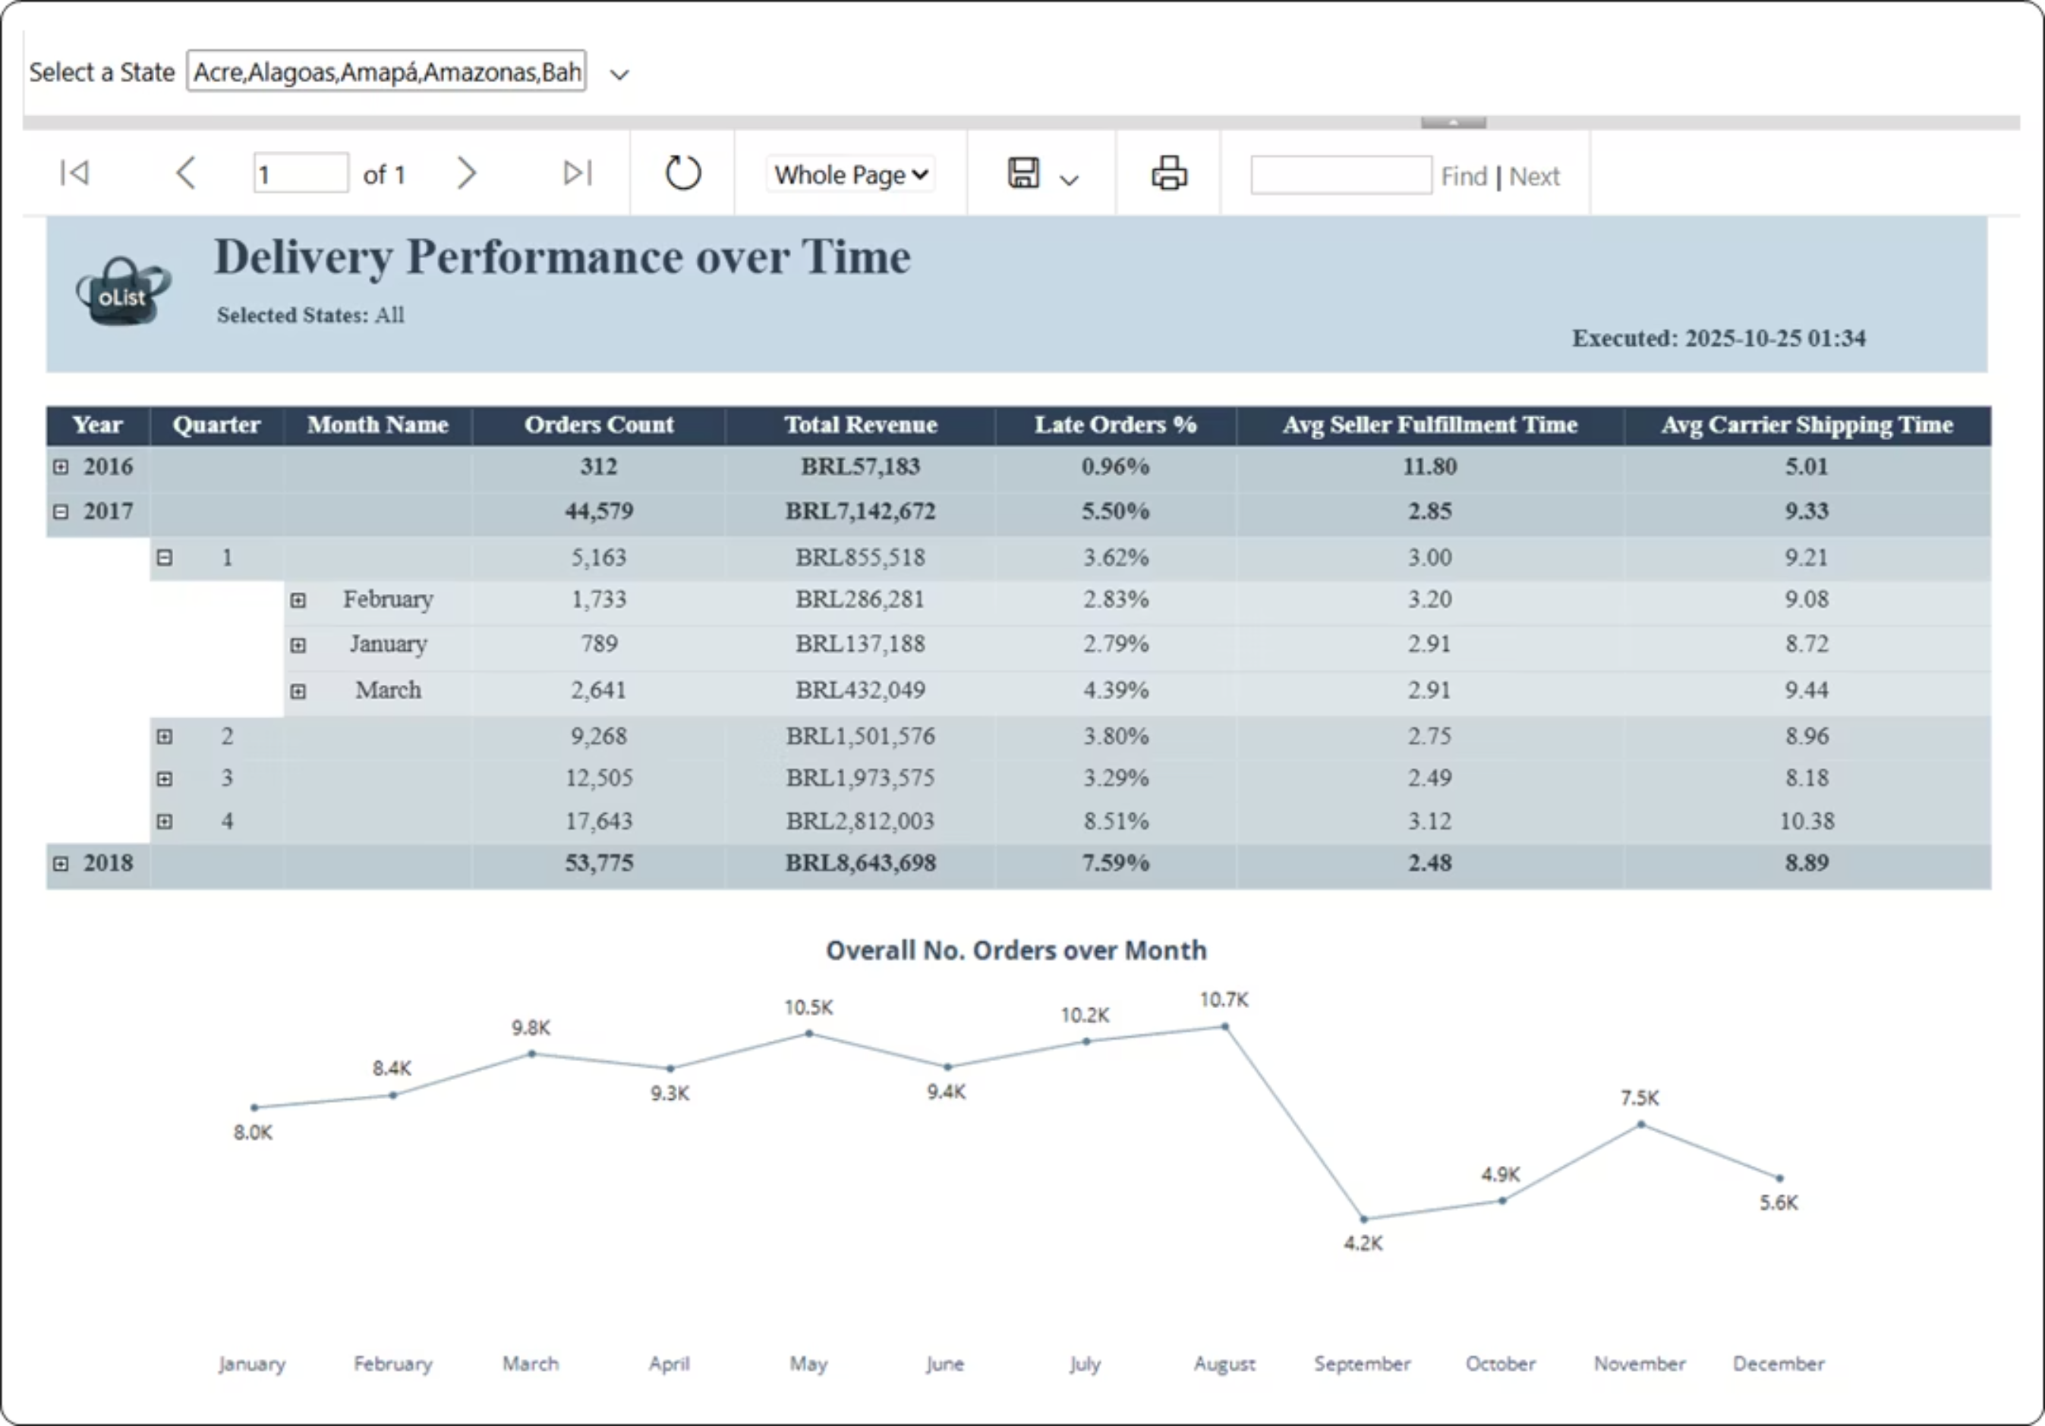

Slide 36
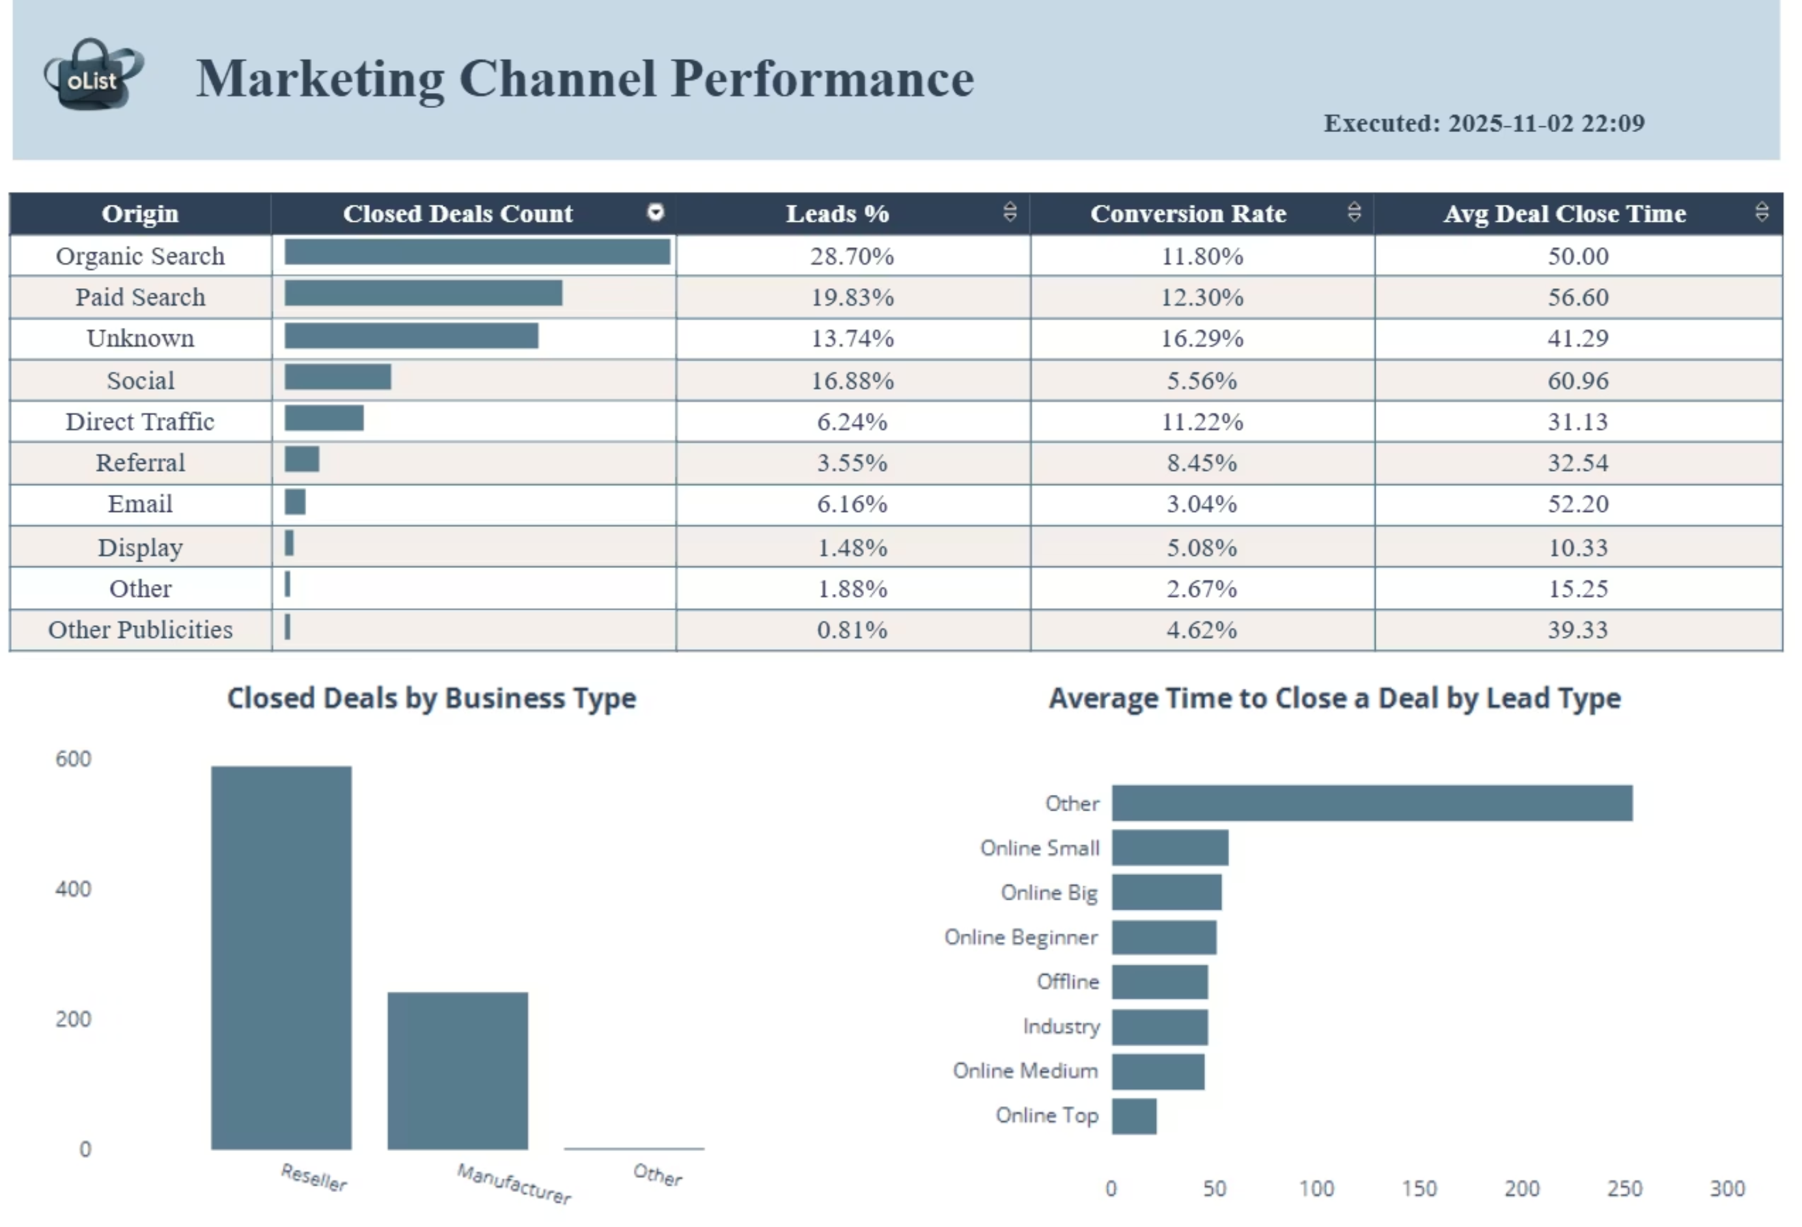

Slide 37
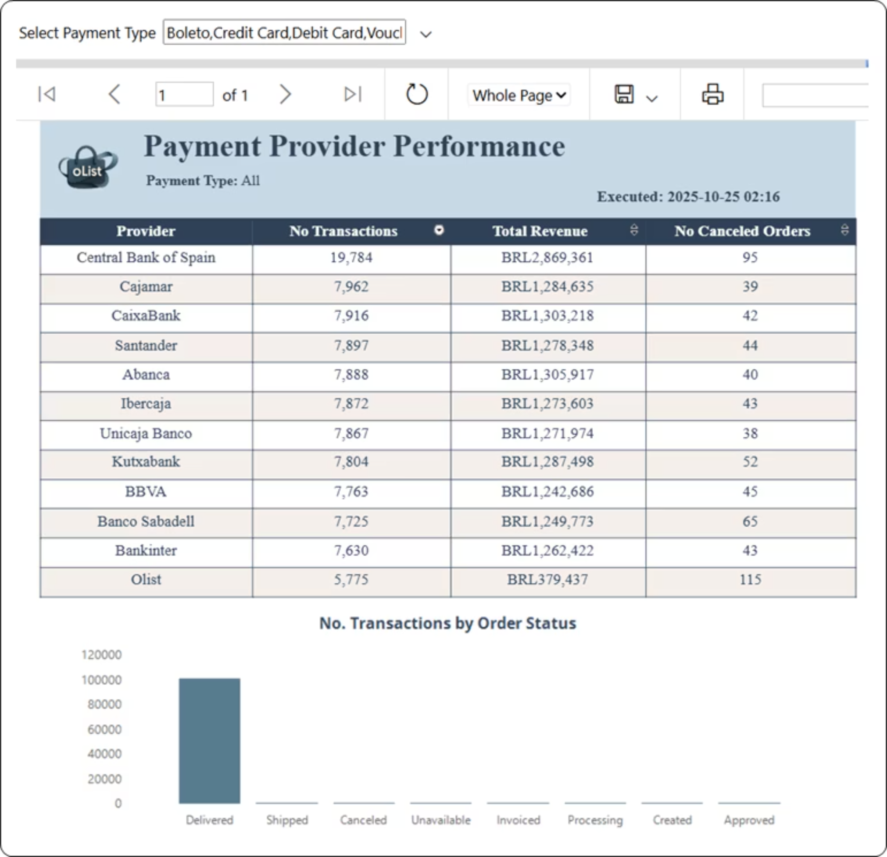

Slide 38
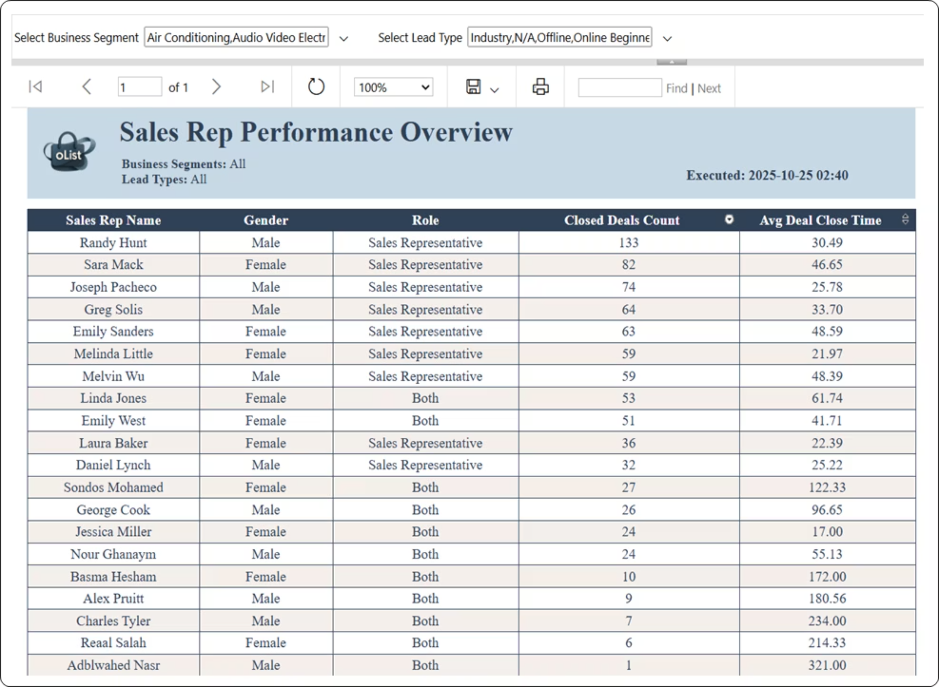

Slide 39
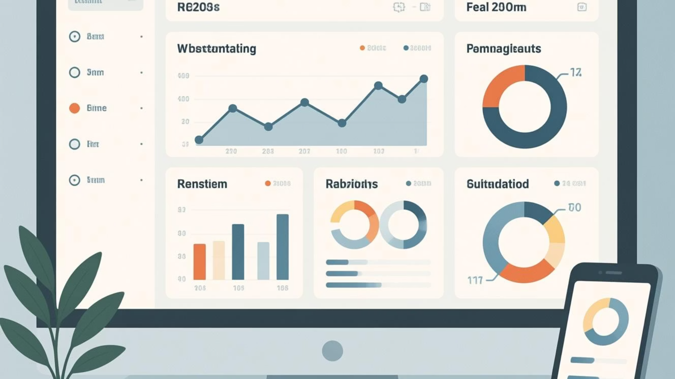

Power BI Dashboards
Transforming complex data into intuitive, actionable insights for strategic decision-making across the enterprise.
Notes:
قبل ما نبدأ في الجزء الخاص بالـ Power BI، حابين ننوّه إن في QR Code ظاهر على السلايد، اللي حابب يقدر يتابِع معانا الـ Dashboard page by page أثناء العرض.

Slide 40
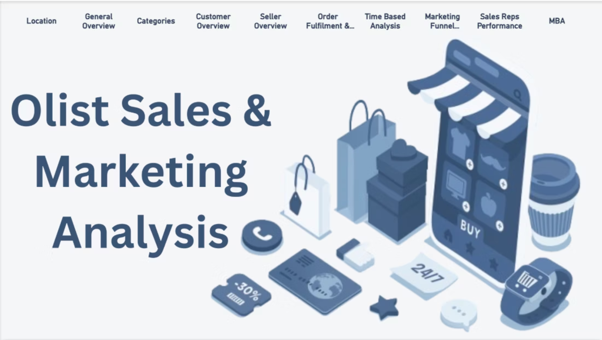
Home Page

Slide 41
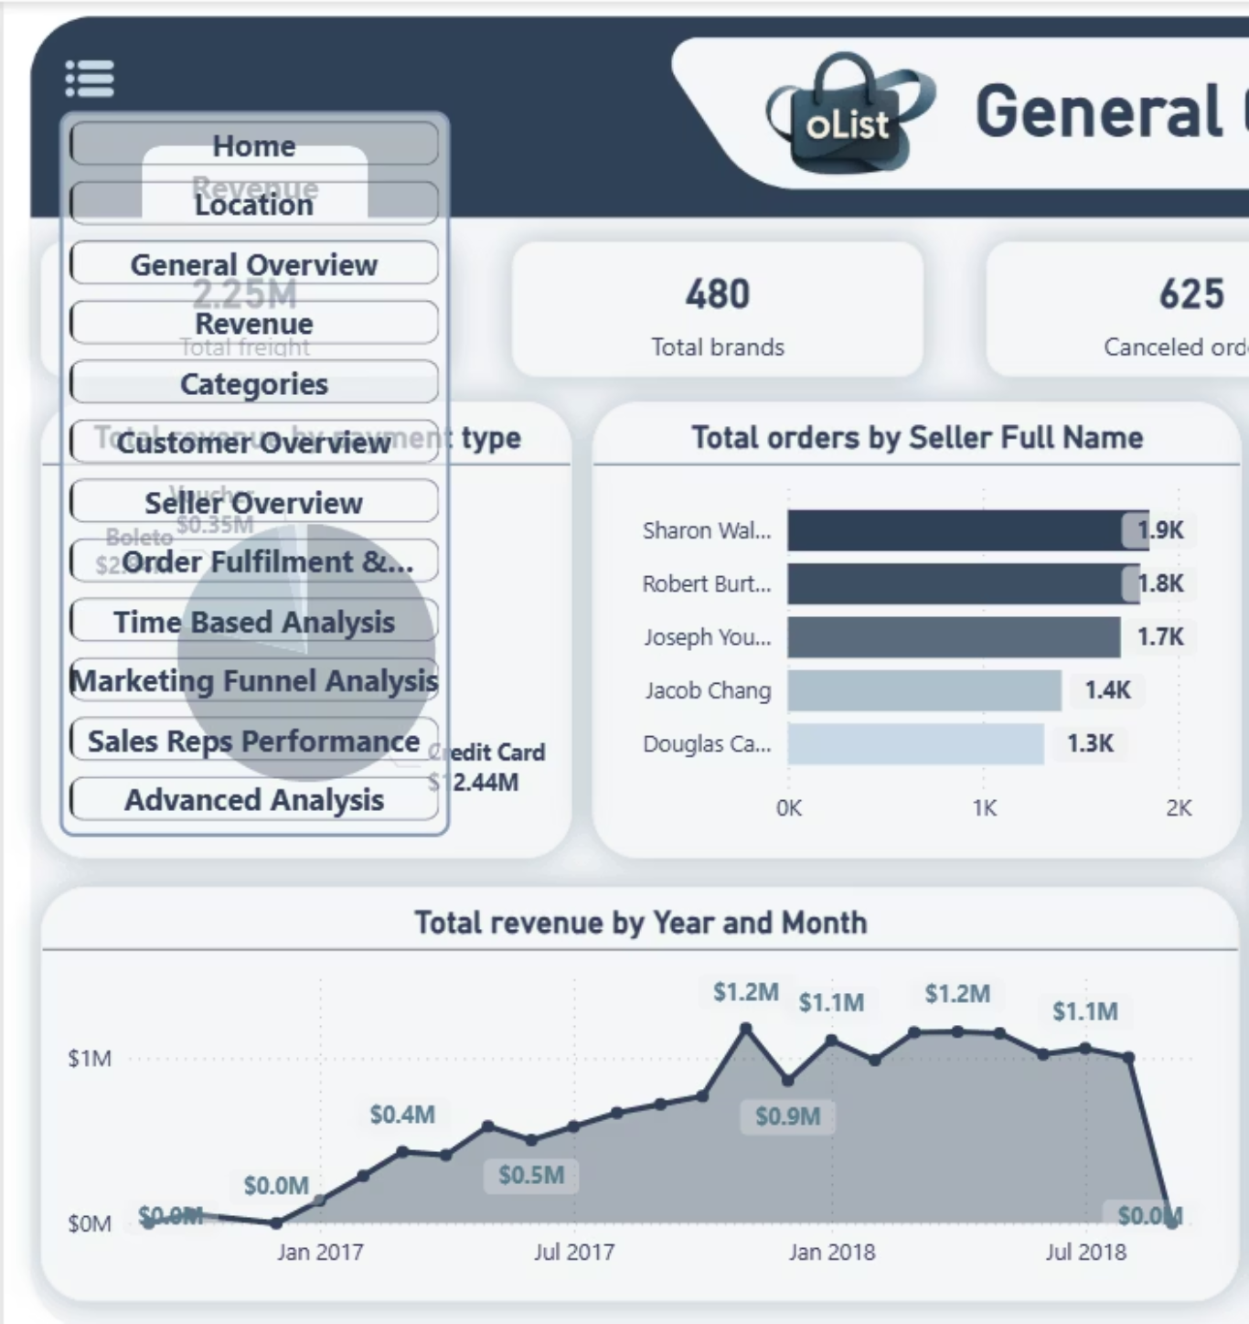
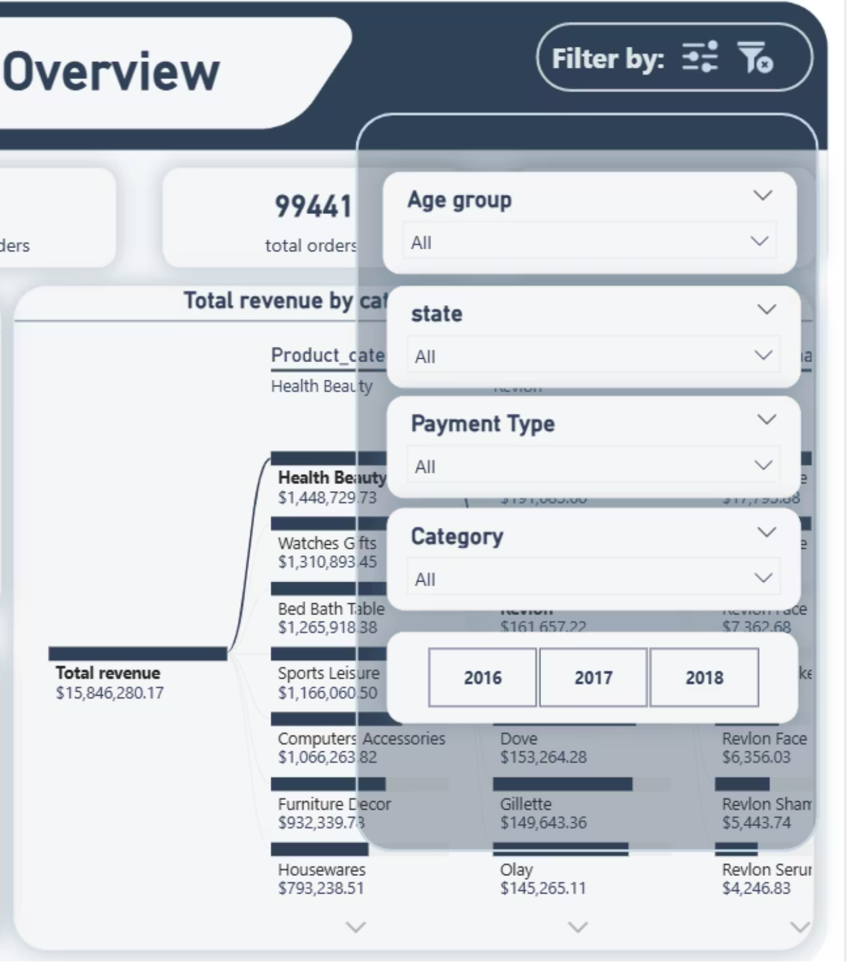
Navigation Panel & Filter Pane
Notes:
استعملنا برده book marks عشان نعمل hidden navigation panel لل main pages
و استعملناها برضه في تصميم ال filter pane

Slide 42
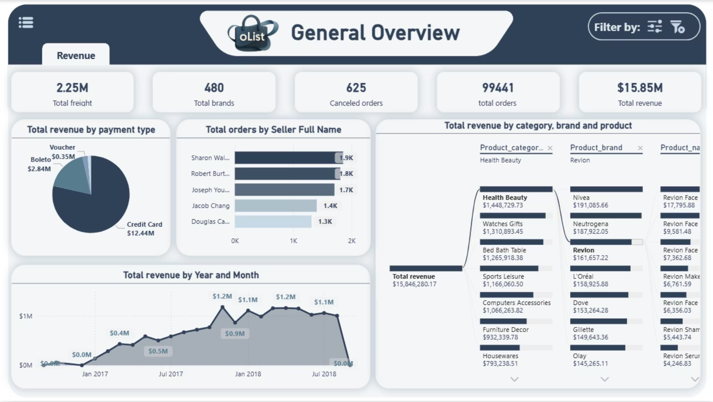
General Overview
Provides an overall business summary through cards (total freight, total brands, canceled orders, total orders, and total revenue).
Notes:
اول page معانا هي general overview
و اللي فيها بنبدأ بنظرة عامة على أداء المنصة ككل
و بنشوف ان ال total revenue وصل لاكتر من 15 مليون بإجمالي عدد orders 99 الف
كمان بنشوف من توزيع ال payment types ان اكتر payment type بيفضلها ال customers كانت ال credit card
و ان من ناحيه عدد ال orders ف sharon Walton كانت اعلى seller باجمالي 1900 اوردر

Slide 43
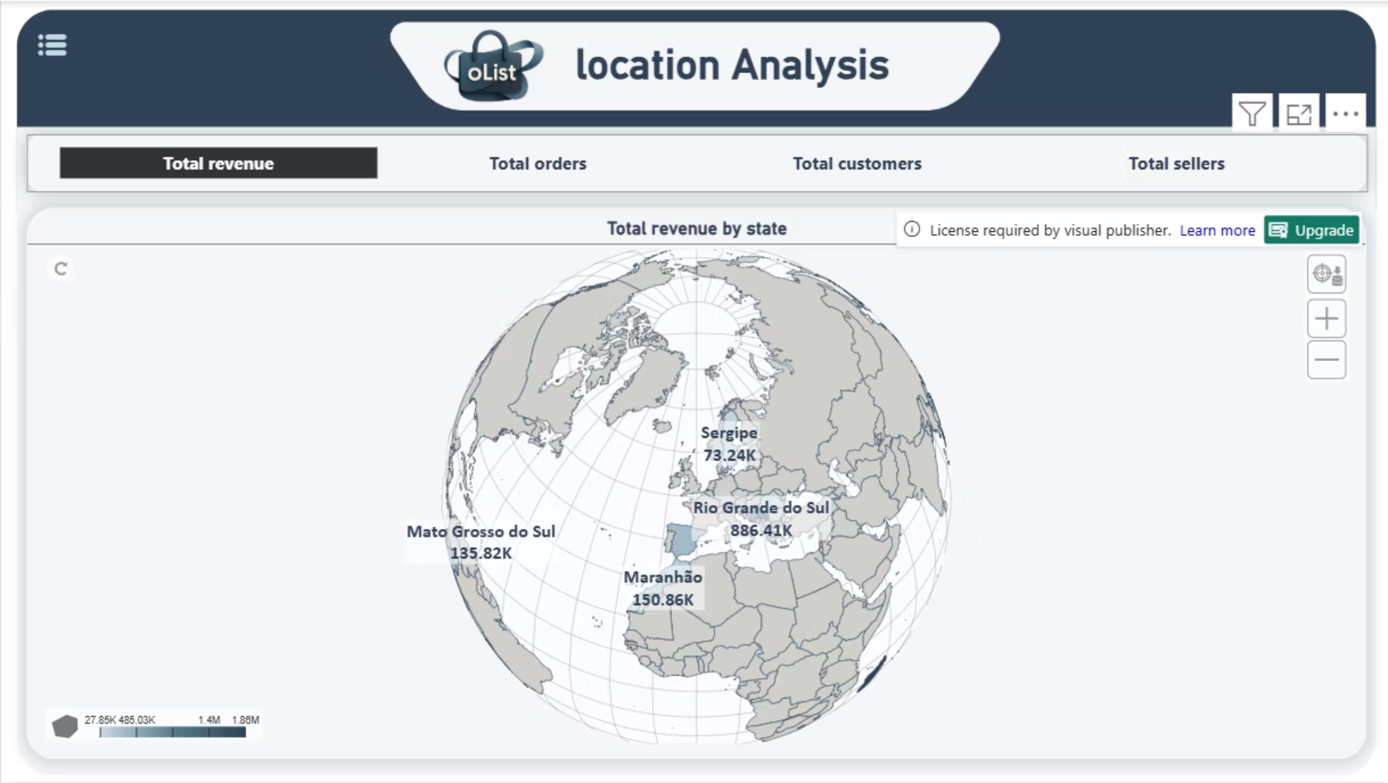
Location Analysis
Features an interactive map supported by a parameter rule that allows switching between main measures
Notes:
في صفحه ال location
هنا بنقدر نشوف الـ Map اللي فيها أكتر من Indicator من خلال الـ Parameters، وده سمح إننا نستخدم نفس الـ Visual لعرض أكتر من Measure — زي الـ Total Revenue، الـ Total Orders ، وكمان الـ Total Sellers per State. ومن التحليل بنلاحظ إن أكتر State حققت Revenue كانت Mato Grosso بإجمالي 1.8 مليون.

Slide 44
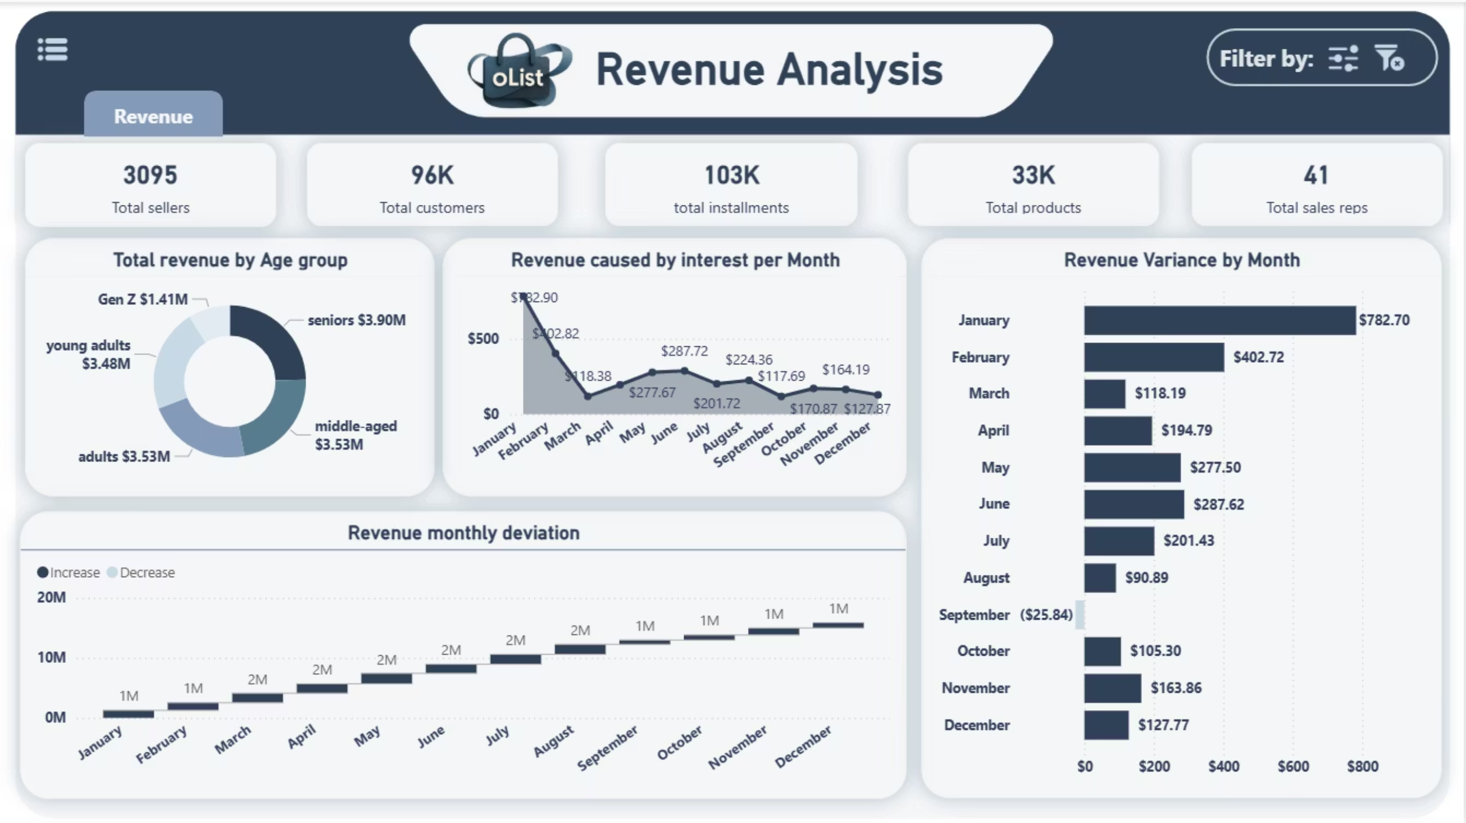
Revenue Analysis
Displays financial insights through cards (total sellers, customers, installments, products, and sales reps). Visuals include a revenue distribution by age group, monthly deviation waterfall chart, interest-based revenue trend, and monthly variance bar chart.
Notes:
بننتقل بعد كده لصفحه ال revenue analysis
و اللي بنتكلم فيها عن ال Revenues بس بتفاصيل أكتر. بنلاحظ ان فئة الـ Seniors كانت الأعلى spending بإجمالي 3.9 مليون. وكمان ال revenue الناتج عن الفوائد على تأخير الpayments كان الأعلى في يناير. من الـ Waterfall Chart بنلاحظ نمو شبه ثابت في ال revenue من شهر للتاني لكن شهر سبتمبر كان الوحيد اللي حصل فيه تأخير في التحصيل، وده واضح في الـ Bar Chart."
وطبعًا نقدر نفلتر الداتا حسب السنة أو الـ State من الـ Filters Pane لو حابين نحللها أكتر.

Slide 45
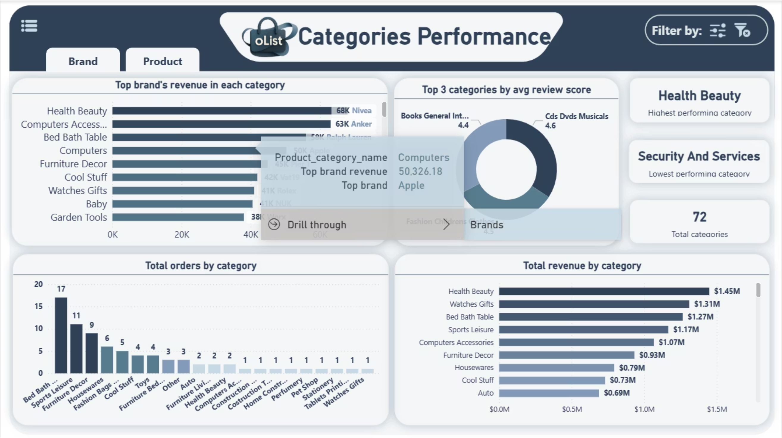
Categories Performance
Highlights category performance with KPIs for the highest and lowest performing categories, and total category count. Users can drill through to brands and products pages, with dedicated bookmarks for filters and navigation.
Notes:
في صفحه ال categories
هنا بنشوف أداء كل category و بنلاحظ ان أعلى Category من حيث ال revenue كانت Health & Beauty، و ان أعلى Brand فيها كانت Nivea. و على الرغم إن Bed Bath Table category كانت الأولى في عدد ال orders الا ان ترتيبها التالت من حيث ال revenue. و ان أعلى categoryمن حيث ال customer review فكانت CDs & DVDs."
و من ال insights دي "نقدر نستفيد من حجم الطلبات الكبير على Bed Bath Table ونعزز هوامش الربح بعروض Upselling، وكمان نحافظ على سمعة CDs & DVDs من خلال Loyalty Programs."

Slide 46
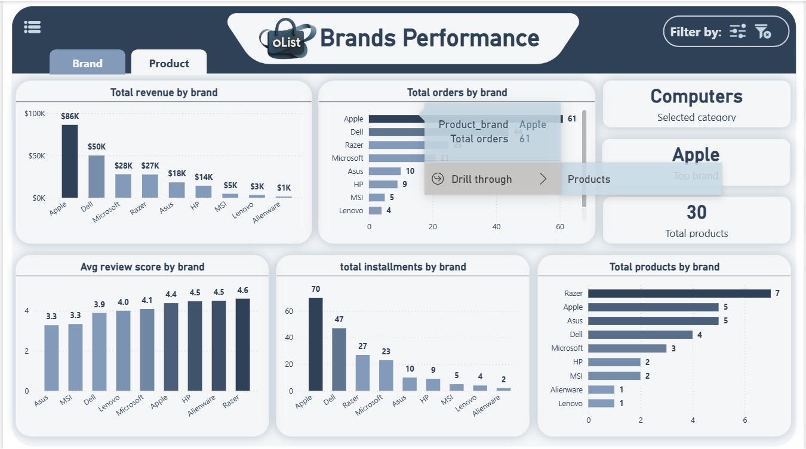
Brands Performance
Focuses on brand-level analysis through KPIs (selected category, top brand, and total products). Drill-through functionality connects to the products page, with bookmarks for filtering and navigation.
Notes:
لما نعمل Drill-through من Computer Category للـ Brand Apple، بنلاحظ إنها الأعلى في ال Revenue داخل الcategory بإجمالي revenue 86 ألف و 61 Order، و على الرغم من كده الا ان تقييمها في المركز التالت من ال customer reviews بمعدل 4.4، وده معناه إن تجربة العملاء محتاجة شوية تحسين في ما بعد البيع.

Slide 47
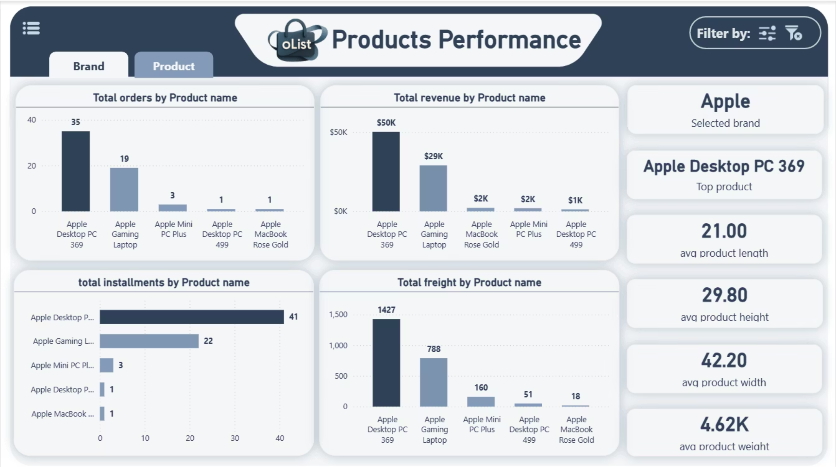
Products Performance
Displays product-specific details through cards (selected brand, top product, and average product dimensions). Buttons and bookmarks allow navigation back to the brands page and access to filtering options.
Notes:
كمان نقدر نعمل drill through من صفحه ال brands لصفحه ال products
و لو بصينا على المثال اللي قدامنا هنلاقي ان اعلى product في ال apple brand
هو apple desktop pc 369 بإجمالي 35 اوردر و 50 الف revenue
و انه كمان اكتر product بيتقسط من ال customers

Slide 48
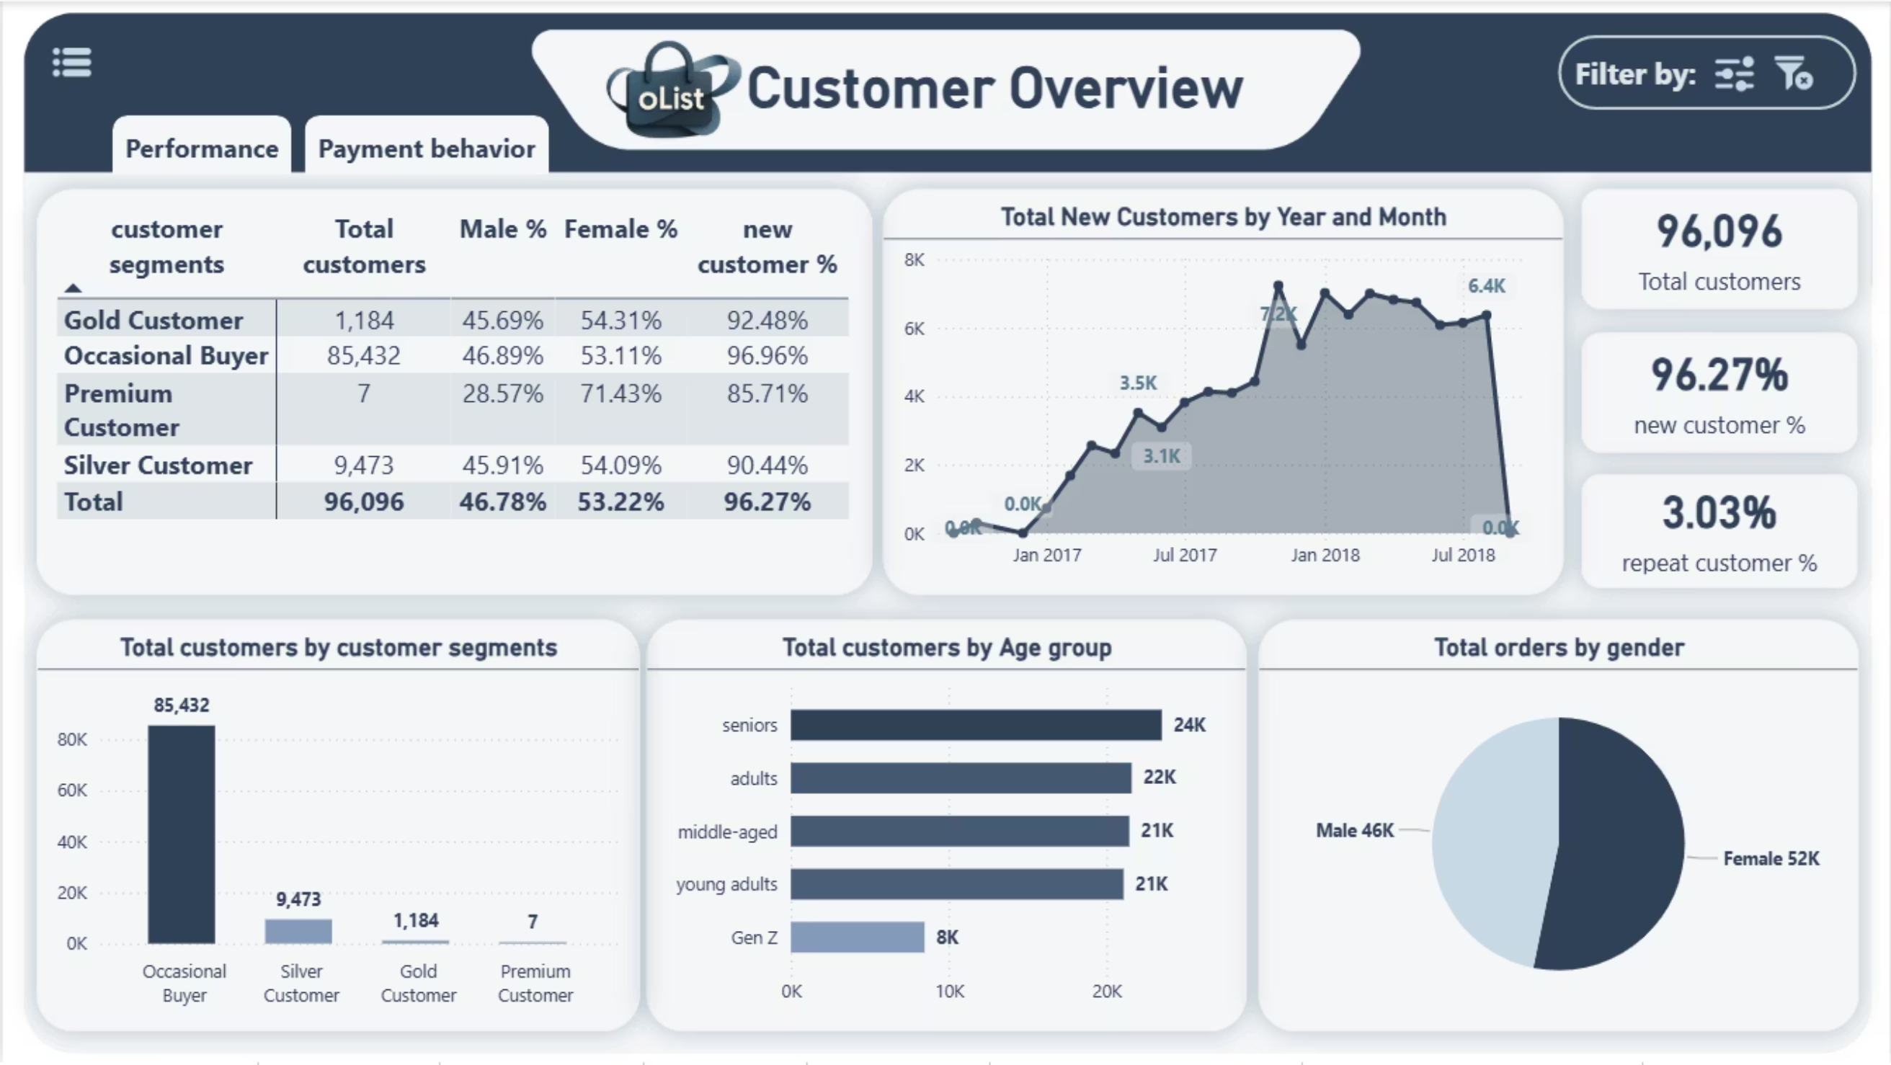
Customers Overview
Summarizes customer insights through KPIs (total customers, new customers %, repeat customers %). Visuals include customer segmentation, gender distribution, new customer trends, and orders by gender.
Notes:
بنروح بعد كده لجزء جديد من الاناليسيز و اللي هو ال customers
بنشوف في صفحه ال customers overview
ان عدد ال customers الكلي حوالي 96 ألف، منهم 96% عملوا Order واحد فقط. 85 ألف منهم مصنفين كـ Occasional Buyers ب revenue أقل من 300، وفيه 24 ألف فوق سن الـ55. و ان النسبة الأكبر من ال customers كانوا Femalesو لكن بفارق بسيط جدًا عن الـ Males."

Slide 49
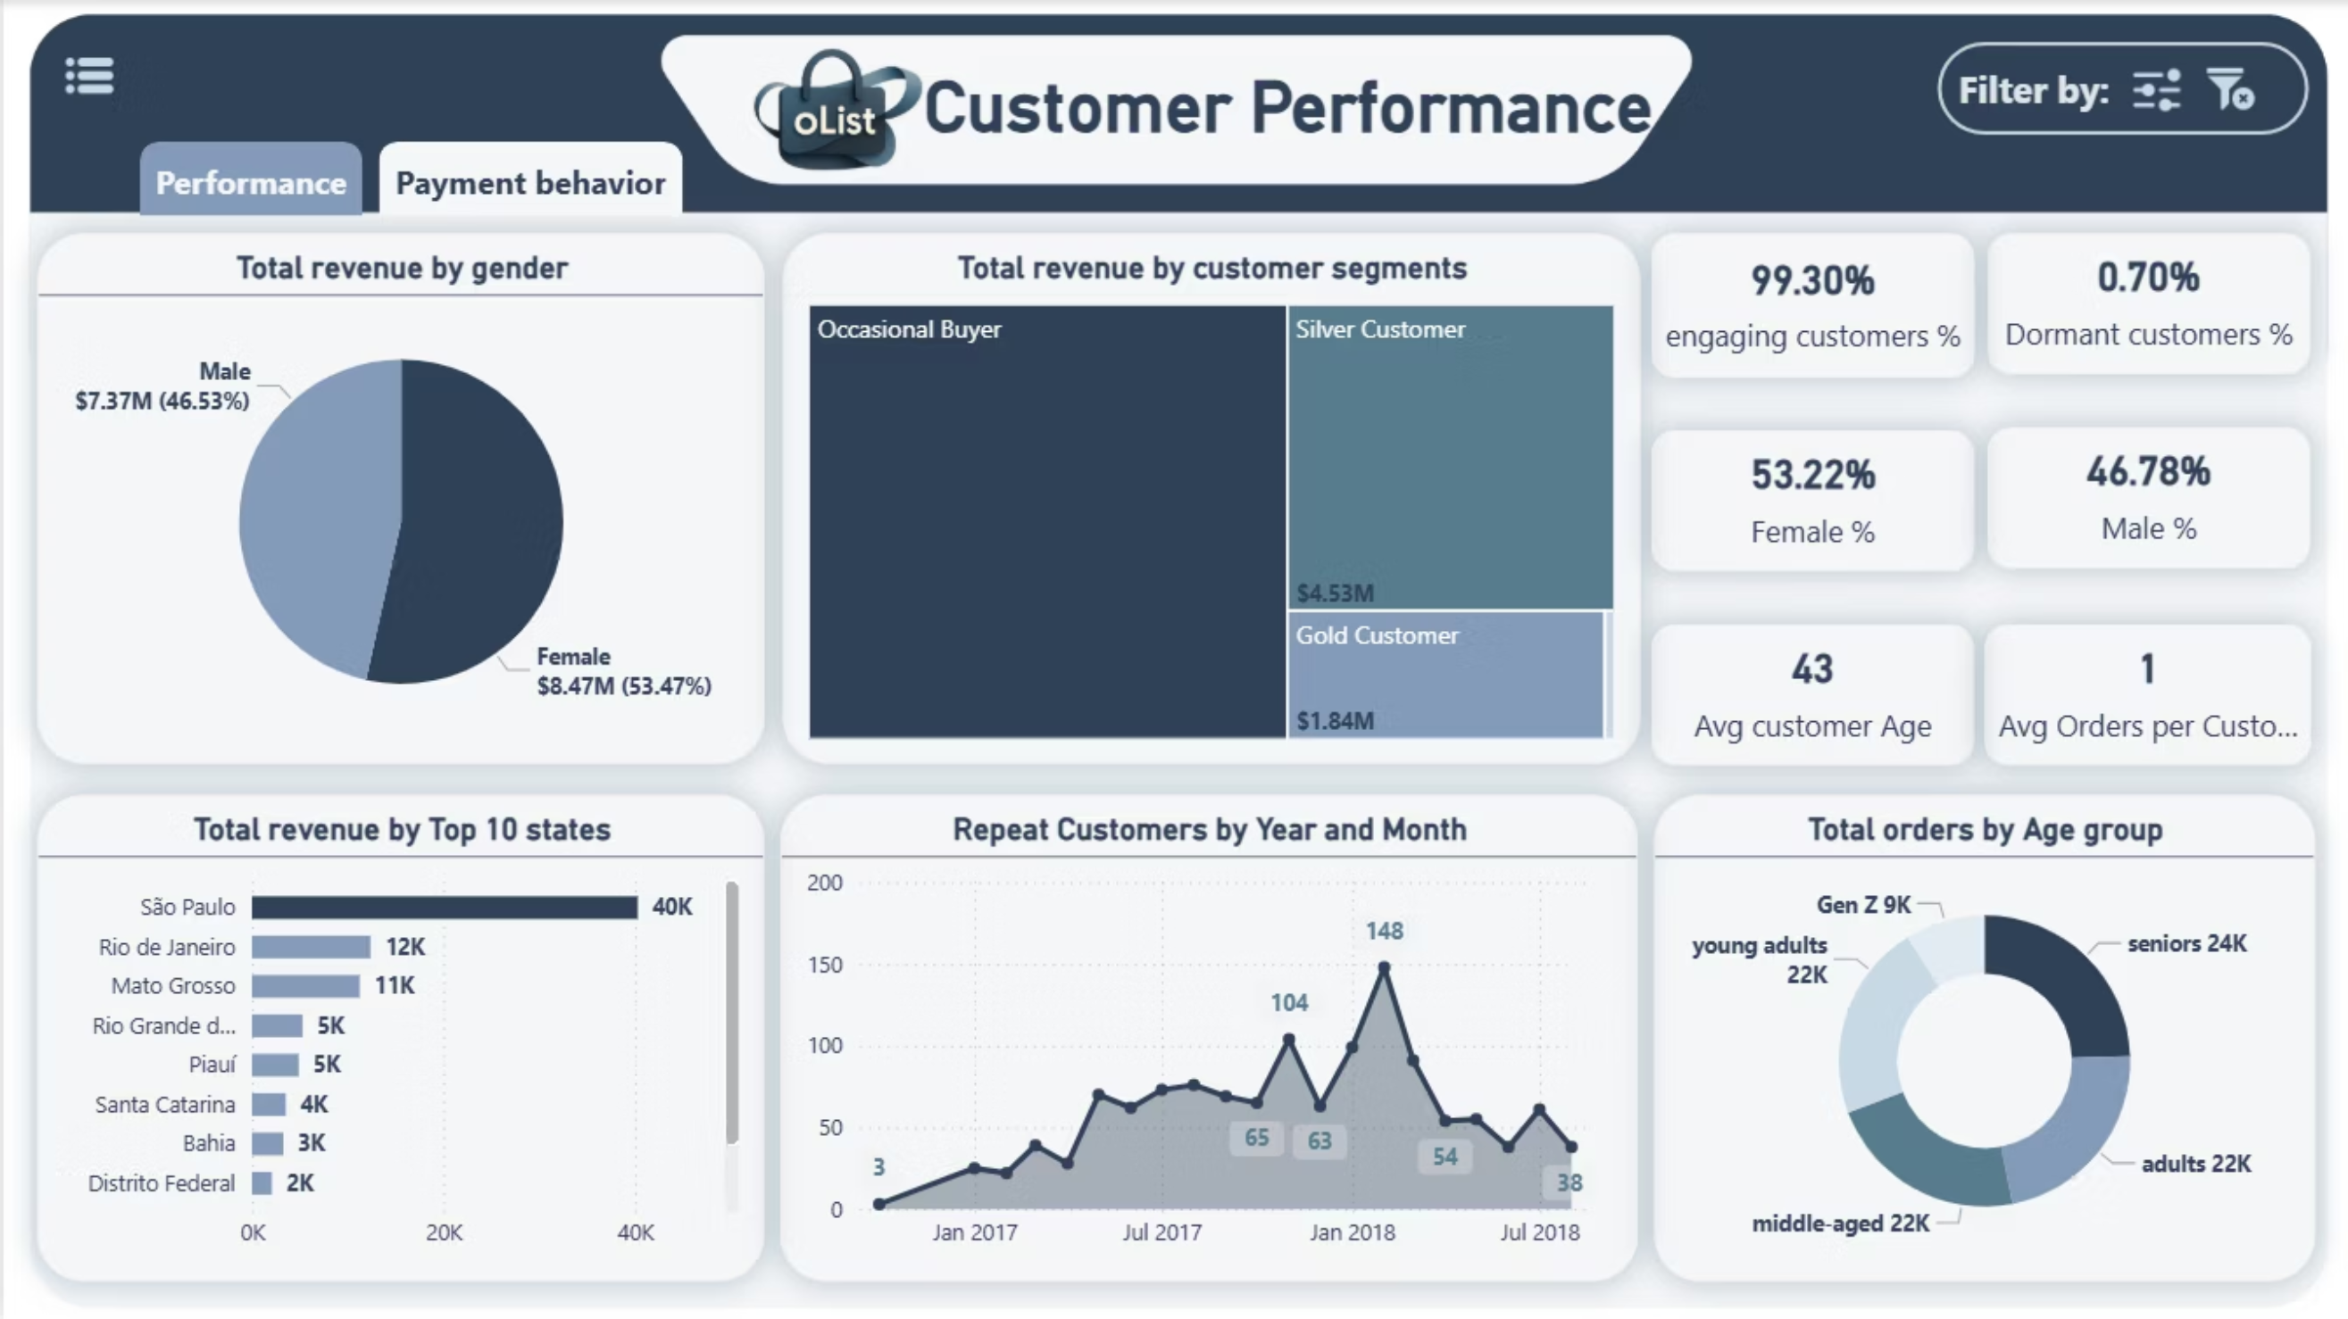
Customers Performance
Measures engagement levels with cards for engaging and dormant customers, gender percentages, average age, and orders per customer. Charts include revenue by gender, revenue by top states, customer segments, repeat trends, and orders by age group.
Notes:
من صفحه ال customer performance
بنقدر نشوف هنا إن ال revenue من ال female أعلى بنسبه بسيطه من ال males ، وإن São Paulo هي ال state الأعلى من حيث عدد ال orders . و ان ال revenue من الـ Occasional Buyers وصل لأكتر من 9 مليون، وشهر فبراير هو الشهر اللي العملاء بيطلبوا فيه تاني بشكل أكبر. وده معناه إنه ممكن يكون أفضل توقيت لحملات إعادة الاستهداف."

Slide 50
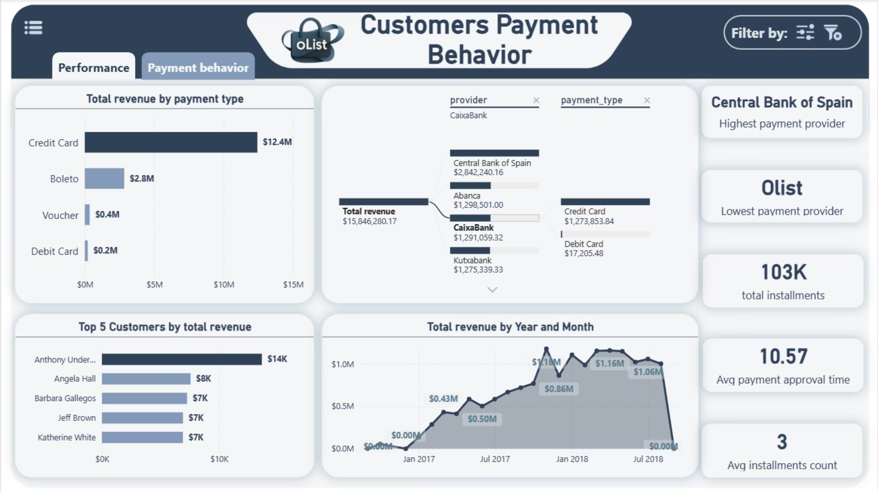
Customers Payment Behavior
Focuses on payment dynamics through KPIs (highest and lowest payment provider, total installments, average approval time, and average installment count). Visuals show revenue by payment type, top customers, provider-type decomposition, and revenue trends over time.
Notes:
من صفحه ال customer payment behavior
بنلاحظ هنا إن الـ Credit Card هي اكتر payment type بيستخدمها ال Customers ، وأعلى Payment Provider هو Central Bank of Spain بإجمالي revenue 2 مليون. أما أعلى customer حققليrevenue فهو Anthony Underwood ب Total ـ14 ألف، ومتوسط ال installments في أغلب المعاملات هو 3 installments."

Slide 51
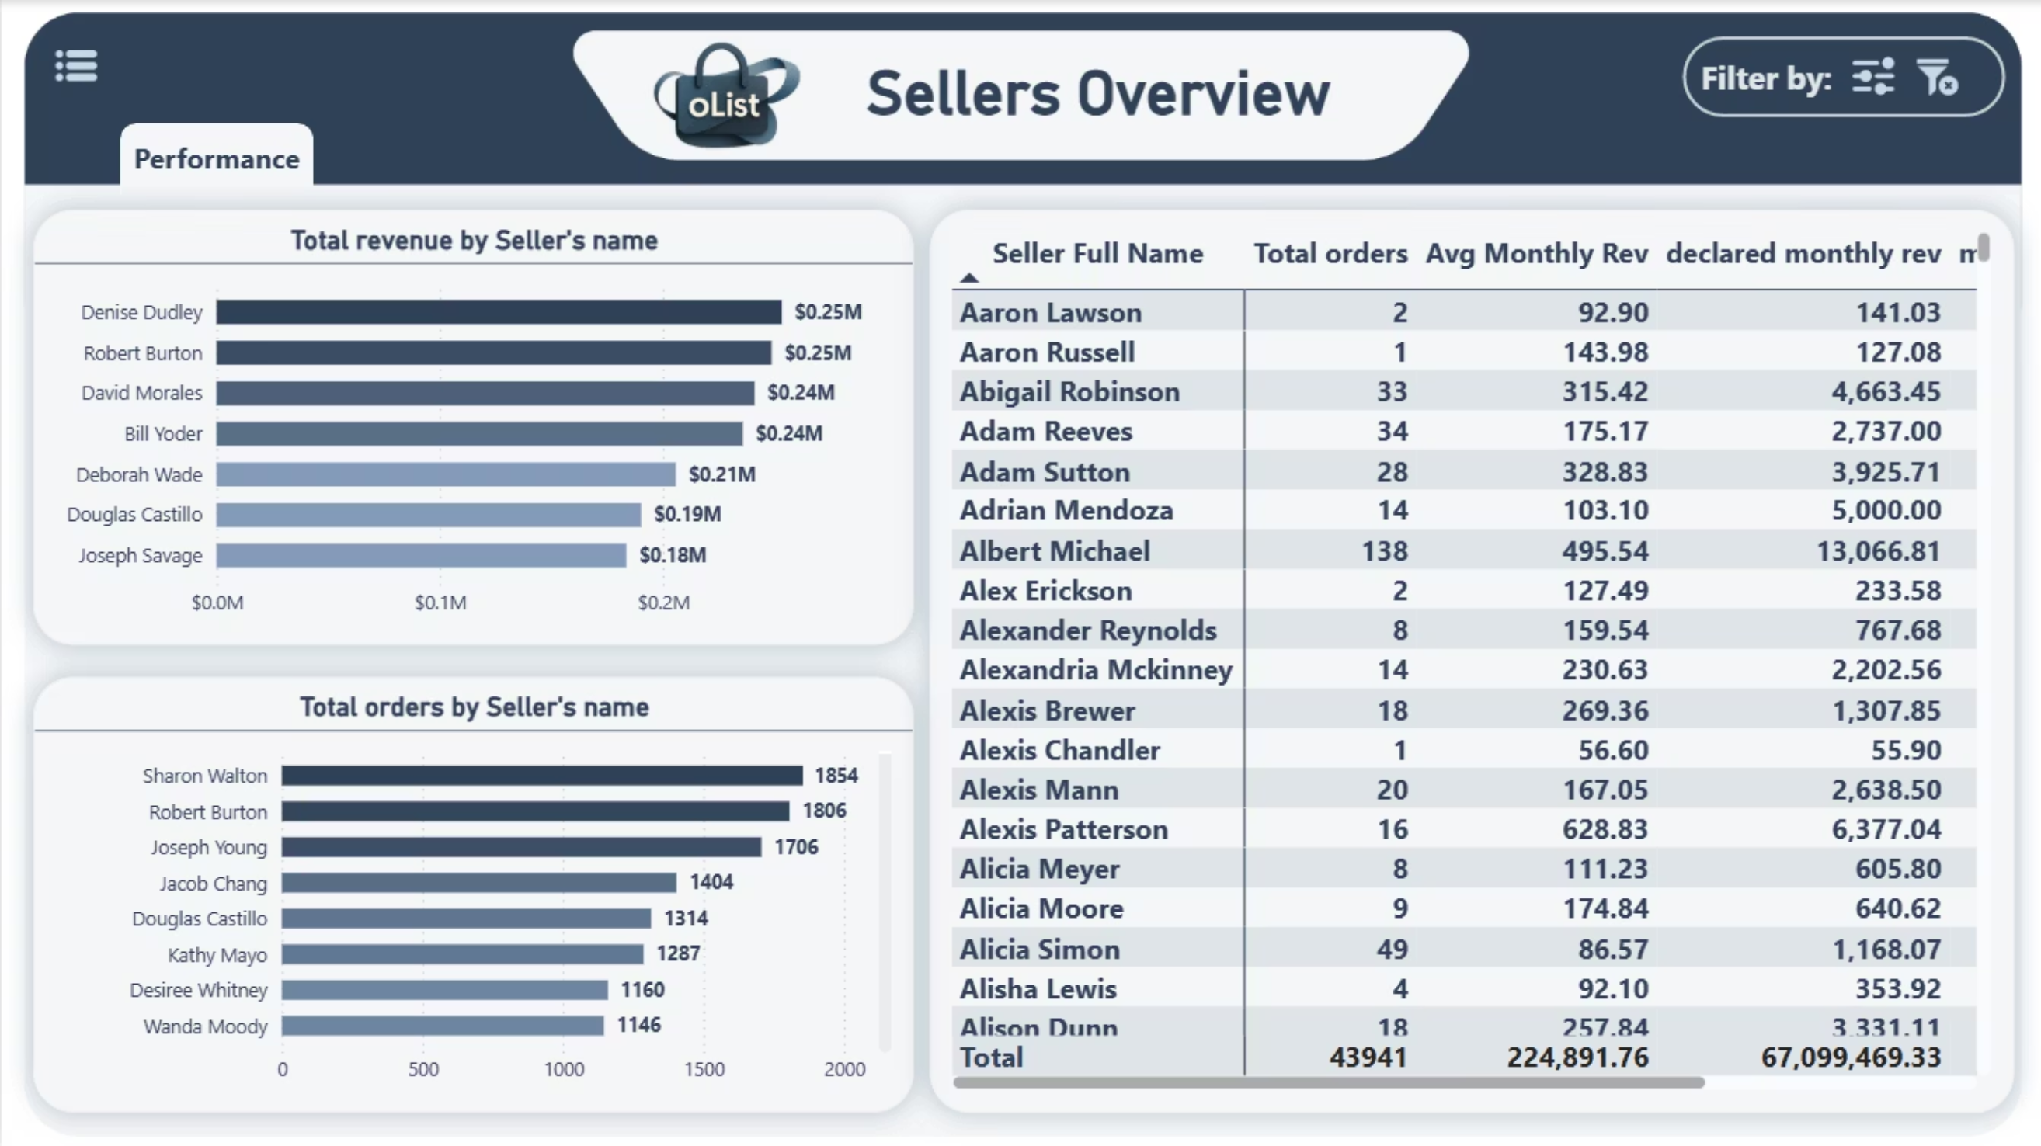
Sellers Overview
Presents seller performance through visuals for revenue and orders by seller, plus a matrix showing total orders, average monthly revenue, and revenue variation. Navigation allows access to the seller performance page.
Notes:
صفحة الـ Seller Overview: الصفحة دي بتوضح مقارنة أداء كل Seller بال revenue المتوقع منه. لو الفرق بال negative ، ده معناه أداء أقل من المتوقع، أما بال positive فده معناه تحقيق أعلى من المتوقع . ومن الملاحظ إن Sharon Walton كانت الأعلى في عدد ال orders ، لكنها مش من ضمن أعلى 7 sellers من حيث ال revenue ."

Slide 52
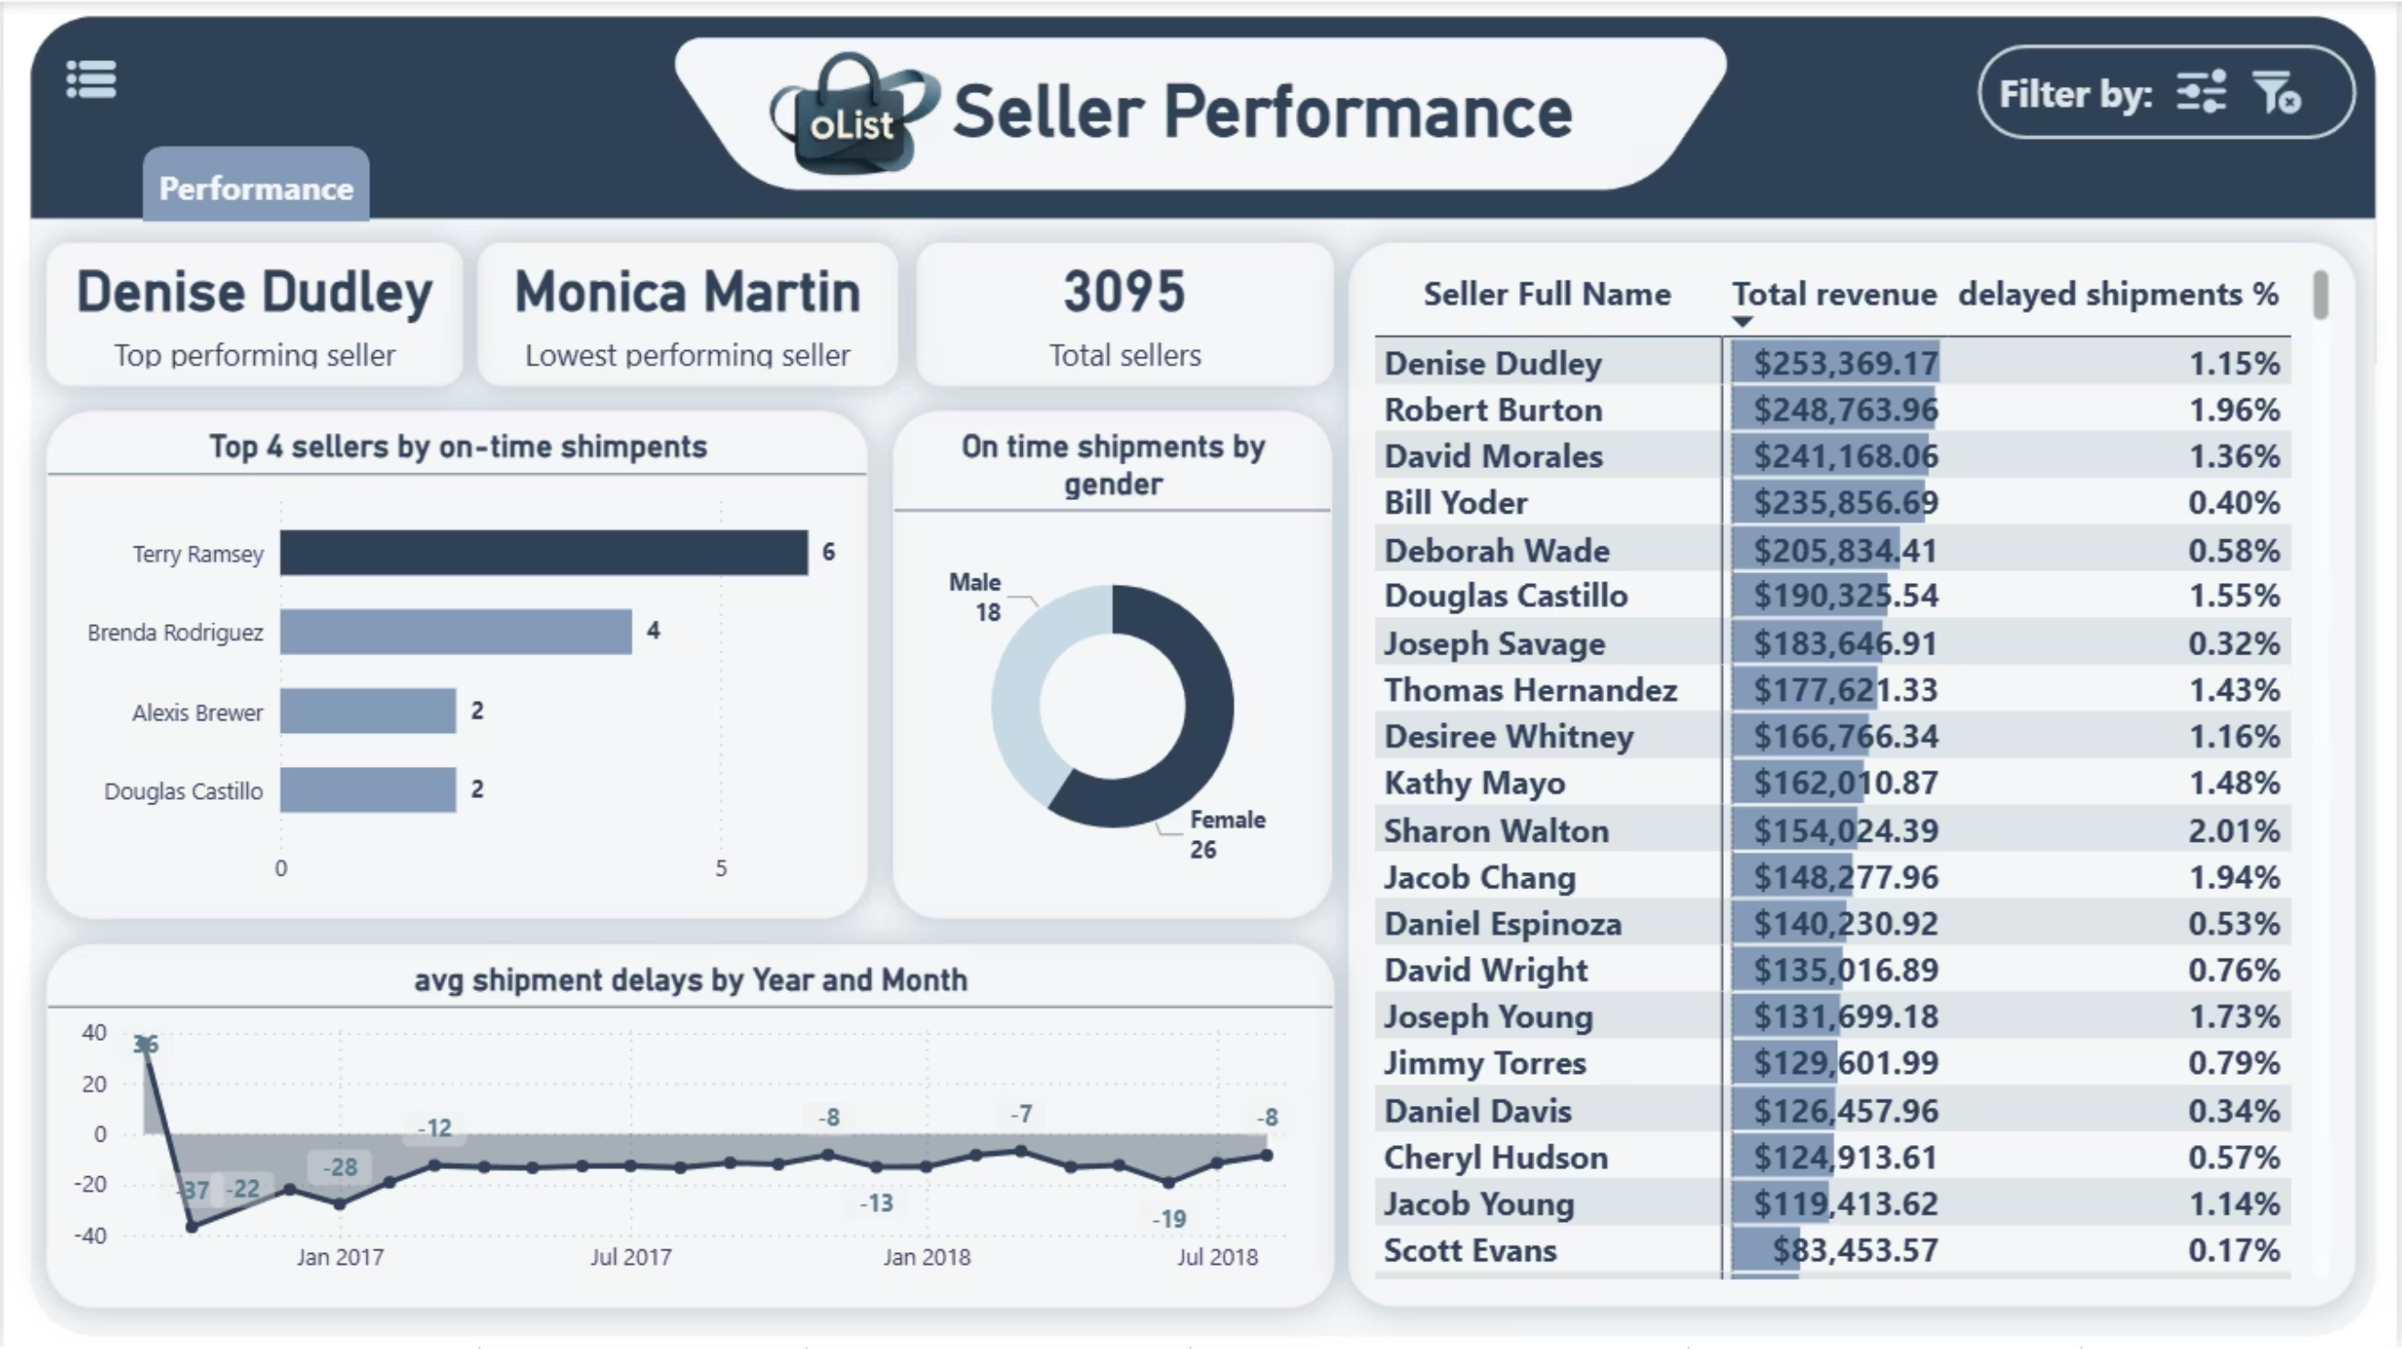
Sellers Performance
Highlights key seller metrics including top and lowest performers, total sellers, on-time shipments, and delivery delays. Charts visualize shipment punctuality, delay trends, and gender distribution among sellers.
Notes:
صفحة الـ Sellers Performance: "Denise Dudly كانت أعلى Seller من حيث ال revenue ، وMonica Martin كانت الأقل. أما أكتر Seller ملتزم بمواعيد ال shipments فكان Terry Ramsy. و ان الـ Female Sellers عمومًا أكثر التزامًا بال shipping time من الـ Males، وأعلى معدل تأخير حصل في أكتوبر 2016 بإجمالي 37 Shipment."

Slide 53

Order Fulfillment & Delivery
Analyzes delivery efficiency with KPIs (total shipments, on-time delivery, delayed delivery, average delivery time, canceled and unavailable orders). Visuals include shipment distribution, delivery status, and delay trends over time, supported by bookmarks for navigation, filtering, and resetting.
Notes:
في صفحة الـ Order Fulfillment & Delivery:
بنشوف ان 97% من ال orders حصلها delivery ، ومن أكتر من 112 ألف Shipment، 101 ألف وصلوا on time . و ان أطول فترة توصيل كانت 55 يوم في سبتمبر 2016."
"وبكده نكون غطينا الجزء الخاص بأداء المنصة من الزاوية التشغيلية والمالية
و دلوقتي هتكمل معانا ال time & marketing analysis البشمهندسه ريئال

Slide 54

Time Based Analysis
This dashboard uncovers how orders and delivery performance vary by day, shift, and time, revealing strong weekday-evening activity with steady growth, yet increasing delays during peak periods. It signals robust demand expansion alongside the need for improved evening shift efficiency to maintain service quality.

Slide 55

Marketing Funnel Analysis
Analyzes marketing funnel efficiency across lead types, highlighting variations in revenue potential, engagement depth, and conversion speed. It reveals high-performing segments driving value quickly while exposing bottlenecks in beginner and smaller online leads.

Slide 56

Marketing Funnel by Lead Behavior Profile
Varies marketing funnel performance across lead behavior profiles, highlighting deep engagement and high revenue in select groups. Varies sales cycle length and MQL output significantly, revealing efficiency in some profiles and bottlenecks in others.

Slide 57

Marketing Funnel by Origin
Centers on lead origin performance in the marketing funnel, tracking MQLs, conversion rates, win speed, and revenue by channel.

Slide 58

Marketing Funnel by Lost Deals
Provides a comprehensive view of lost leads performance across origins and loss stages, highlighting key KPIs such as lost revenue, lead volume, and catalog size. Enables insight into major loss drivers and high-impact channels for strategic marketing improvements.

Slide 59

Sales Reps Performance
Highlights sales representatives’ performance through KPIs such as closed deals, total revenue, and lead engagement. Provides insights into seller segments and conversion efficiency, supporting data-driven evaluation of sales effectiveness.

Slide 60

Sales Rep Overview
Provides a detailed view of an individual sales rep’s performance, combining personal profile data with key sales KPIs. Tracks closed deals, revenue trends, and lead type performance to assess overall contribution and growth.

Slide 61

Advanced Analysis
This dashboard focuses on sentiment and association analysis by combining Market Basket Analysis (MBA) and customer review insights. It enables the exploration of product relationships and sentiment trends, with KPIs summarizing total, positive, and negative reviews for performance evaluation.

Slide 62
Questions & Discussion
Thank you for your attention. We are now open for any questions you may have regarding our End-to-End Business Intelligence Project.

Slide 63

Thank You
We appreciate your time and engagement with our End-to-End Business Intelligence Project. Our goal was to provide actionable insights and enhance data-driven decision-making, and we hope this presentation has demonstrated the value we bring.

